Slide 1
Service-oriented Software Engineering (SoSE)
Describing REST WS with Open API and Swagger
Alfredo Farò - 303211
University of L’Aquila
alfredo.faro@student.univaq.it
(MIDTERM EXAM MAY 2025)

Slide 2
What have we done? (from previous lectures)
When a service exposes a complex interface and is not just a simple resource (e.g., involving many parameters, nested objects, or custom logic), it becomes hard to model using RESTful principles alone.
Unlike SOAP-based services, which benefit from WSDL (Web Services Description Language) to formally describe all operations and message types, REST lacks a native standard for interface description.
As a result, REST APIs are often documented:
Informally (e.g., README files, Confluence pages)
Inconsistently (different teams use different formats)
With no machine-readable format to generate clients or test tools
This creates confusion and raises the barrier for reusing or integrating with the API.
WADL
OpenAPI
WADL was an early XML-based attempt to describe REST interfaces.
✅ Pros:
Tried to bring structure to REST descriptions
❌ Cons:
XML-heavy and verbose
Poorly adopted
Lacked community and tooling support
The OpenAPI Specification allows you to:
formal documentation of REST endpoints (in YAML or JSON)
interactive exploration and testing through Swagger UI
automatic client/server code generation
easy integration into CI/CD pipeline
REST by itself doesn’t provide a way to formally describe APIs.OpenAPI fills that gap, giving REST the structure and tooling it was missing.es

Slide 3
What is Swagger?
What is Swagger (and OpenAPI)?
Swagger is a set of tools used to design, document, and test RESTful APIs, based on the OpenAPI Specification.
OpenAPI is the official standard to describe REST APIs using JSON or YAML.
Swagger provides tools to work with OpenAPI, including:
Swagger Editor: write your API definition
Swagger UI: test your API in the browser
Swagger Codegen: generate clients/servers automatically
Swagger History
Swagger started as a specification and tooling suite.
In 2015, the OpenAPI Specification (OAS) was donated to the Linux Foundation.
Today, OpenAPI is the name of the standard, and Swagger is the name of the tools built around it.
With Swagger, you can:
Document your REST API in a clear and structured way
Test endpoints via an interactive web interface (Swagger UI)
Generate client/server code and test suites (e.g., JUnit)
2017 – OpenAPI 3.0
First version under the name OpenAPI Specification (OAS).
YAML fully supported.
Introduction of reusable components (schemas, parameters, responses, etc.).Improved support for media types, headers, authentication.
2014 – Swagger 2.0
- Specification written in JSON.
- Official tools launched: Swagger Editor, Swagger UI, Swagger Codegen.
2010 – Swagger is born
Created by Tony Tam (Wordnik) to write API REST
Swagger Specification is born (v1.0 → 1.2 → 2.0)
2015 – OpenAPI Initiative is born
Swagger Specification donated to the Linux Foundation.
The OpenAPI Initiative (OAI) was formedGoal: create an open, vendor-neutral standard for describing REST APIs.
2021 – OpenAPI 3.1
Fully compatible with JSON Schema 2020-12.
Improved validation and tooling support.

Slide 4
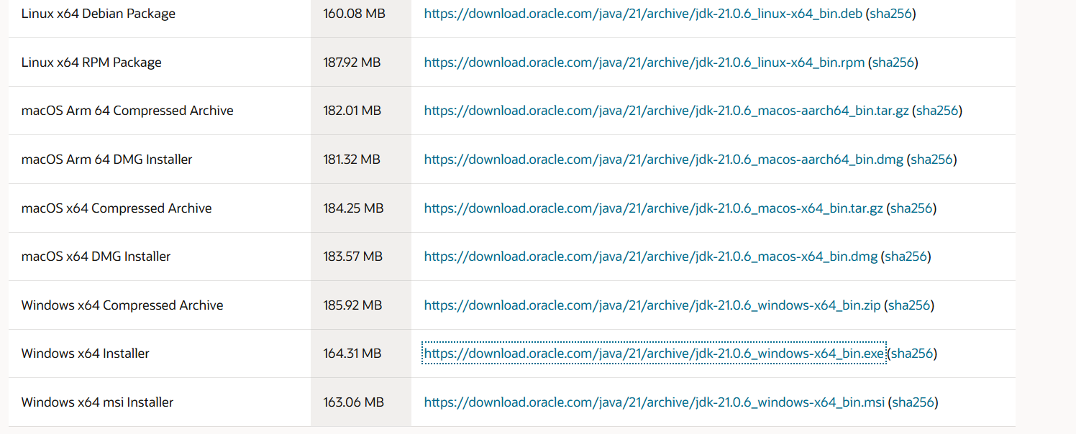
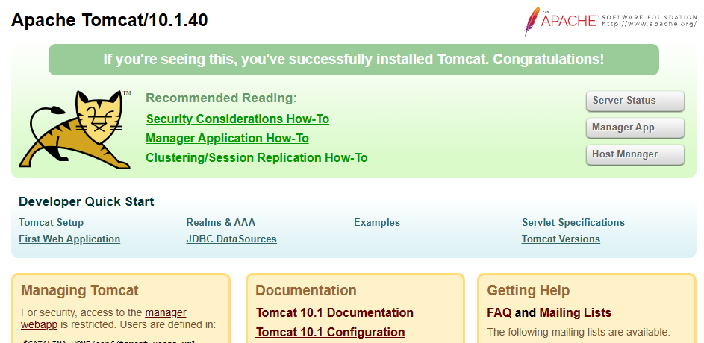
Ingredients – with the lastest versions available as May 2025
Java SE Development Kit:
✅ Latest version: JDK 21 (LTS) 🔗 https://www.oracle.com/java/technologies/javase/jdk21-archive-downloads.html ⚠️ JDK 8 is still supported in legacy systems but consider using JDK 17 or 21 for modern development.
Eclipse IDE for Enterprise Java Developers ✅ Latest: Eclipse IDE 2024-03 🔗 https://www.eclipse.org/downloads/packages
Apache Tomcat
✅ Latest stable: 10.1.40 (as of May 2025)
🔗 https://tomcat.apache.org/download-10.cgi
⚠️ Version 9 is still maintained but 10.x is recommended.
Apache CXF
✅ Latest stable: 4.0.3
🔗 https://cxf.apache.org/download.html
⚠️ Version 3.5.x still works, but version 4 adds better OpenAPI 3.1 support and Jakarta EE 10 compatibility.
Apache Maven
✅ Latest: 3.9.6
🔗 https://maven.apache.org/download.cgi
Swagger Editor
✅ Latest stable: 4.0.3
🔗 https://cxf.apache.org/download.html

Slide 5
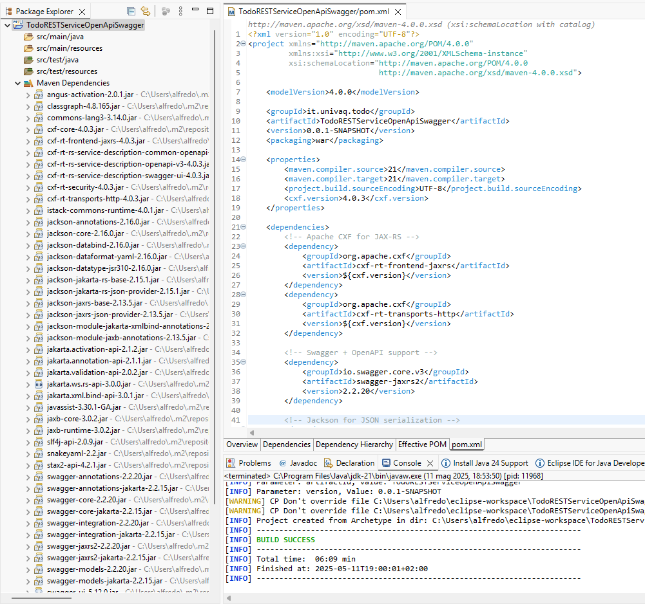
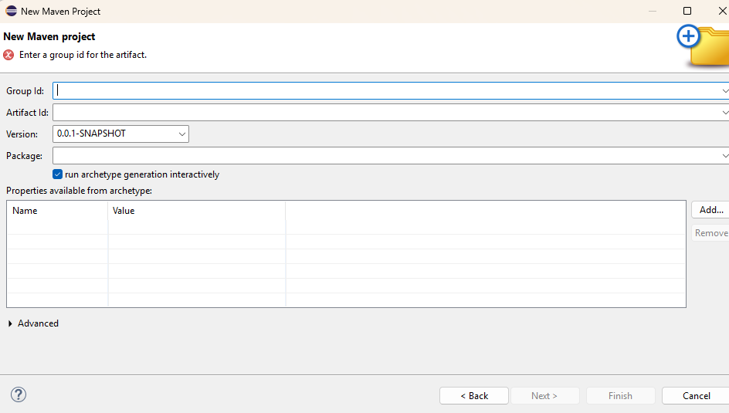
Create TodoRESTServiceOpenApiSwagger
We install Eclipse and configure Java and Maven to the previously defined versions to the system
0
1
Let's create a new maven project and configure the new jdk and the maven version we have installed
2
Define archtype, groupid and let’s create “java”, a folder for our file (also that one for the tests)
3
Define archtype, groupid and let’s define java folder for our file (also that one for the tests)
4
Update the pom.xml with the dependencies and let’s update maven

Slide 6
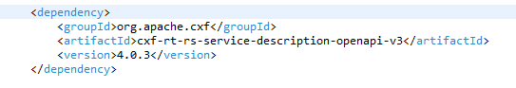
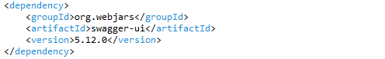
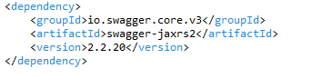
Add Openapi and Swagger dependencies
Apache CXF OpenAPI generator
Enables automatic generation of openapi.json from JAX-RS endpoints.
1
2
Swagger UI (WebJars)
Provides a ready-to-use web client to interact with the API directly in the browser.
3
Swagger Core + Annotations
Offers the necessary annotations to describe REST endpoints using the OpenAPI 3.0 standard.

Slide 7
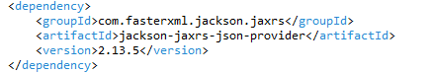
Add jackson-jaxrs-json provider dependency
Jackson JSON Provider
Automatically converts Java POJOs into JSON and vice versa.
4
We include the Jackson JAX-RS JSON provider in our project in order to handle automatic conversion between Java objects (POJOs) and JSON payloads.
This library enables automatic serialization and deserialization of Java objects to/from JSON, based on application/json content type.It integrates seamlessly with Apache CXF and JAX-RS, acting as the MessageBodyReader/Writer for JSON.

Slide 8
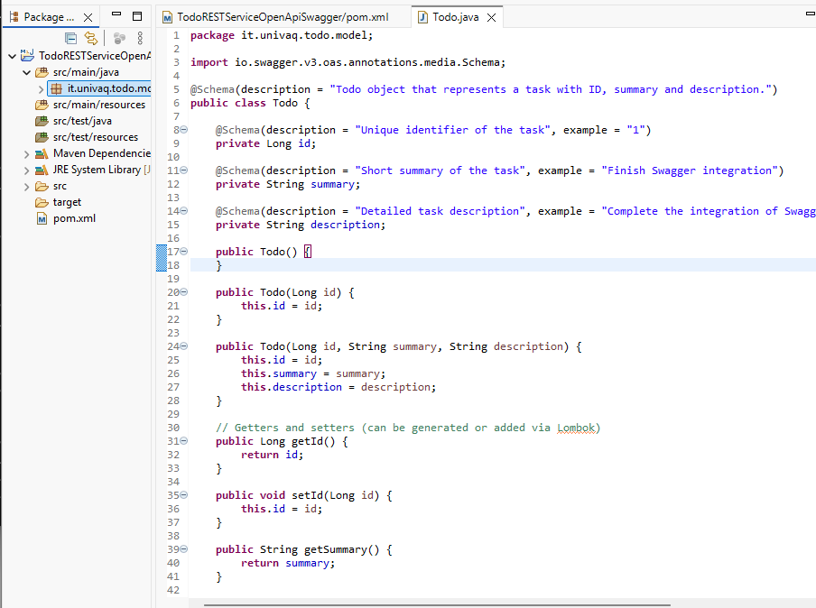
Create the Todo Class (it.univaq.todo.model)
The Todo class represents the data model used in our RESTful web service.It includes an id, a short summary, and a longer description field.Using @Schema annotations (from the OpenAPI specification), each field is documented for automatic Swagger UI generation.
These annotations allow:
clear documentation of fields
example values in Swagger UI
automatic schema generation in openapi.json

Slide 9
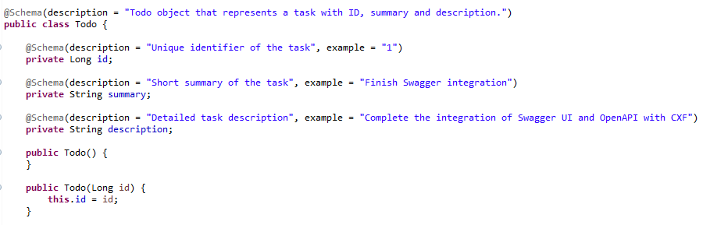
Annotation @Schema

Slide 10
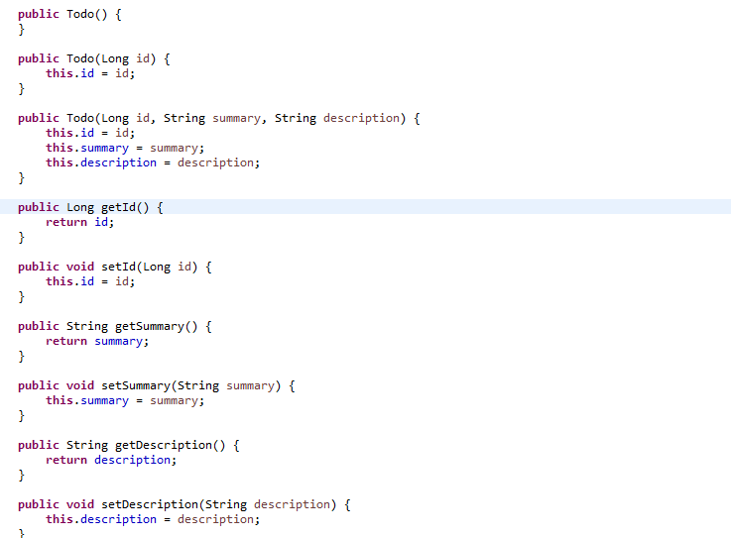
Create the Todo Class

Slide 11
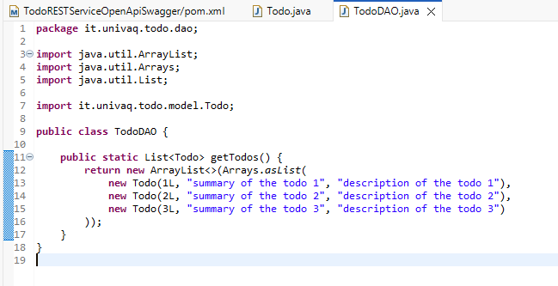
Create the TodoDAO class
The TodoDAO class provides a static list of Todo objects to simulate a database.It follows the DAO pattern to separate the data source from the rest of the application.The getTodos() method will be called by the REST controller to return the list of tasks in JSON format.

Slide 12
Just not to forget... ☺
In RESTful web services, the four main HTTP methods are directly mapped to CRUD operations:
POST → Used to create a new resource
GET → Used to read an existing resource or a list of resources
PUT → Used to update an existing resource
DELETE → Used to remove a resource
In the project, these operations will be exposed through endpoints defined in the REST controller, such as:
GET /todos → get all tasks
POST /todos → add a new task
PUT /todos/{id} → update a task
DELETE /todos/{id} → delete a task
These methods are also fully documented in Swagger UI using @Operation and @ApiResponse.

Slide 13
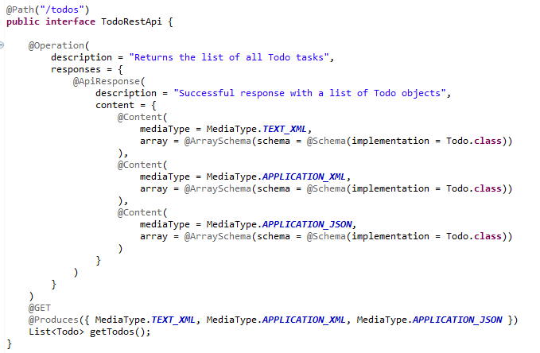
Create the TodoRestApi Interface
@Path("/todos") to define the resource URI
Provides a description of the REST operation for the OpenAPI (Swagger) documentation.
Describes a possible response returned by the method.
Specifies the content type and the structure of the response body.
Indicates that the returned value is a list or array of elements, and each element follows the given schema.
Specifies the Java class model used for the schema generation in the documentation.Swagger UI will display the fields of the Todo class.

Slide 14
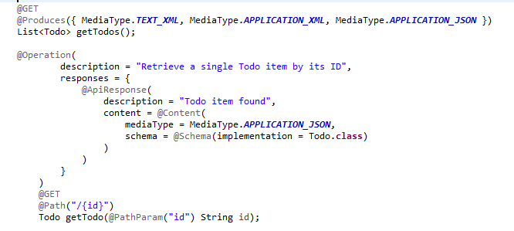
Create the TodoRestApi Interface
@Operation and @ApiResponse document the endpoint in Swagger
The @Schema(implementation = Todo.class) annotation defines the expected response model
@Path("/{id}") defines a dynamic path parameter for the requested item
@GET marks the method as an HTTP GET handler
@PathParam("id") maps the path variable to the method parameter

Slide 15
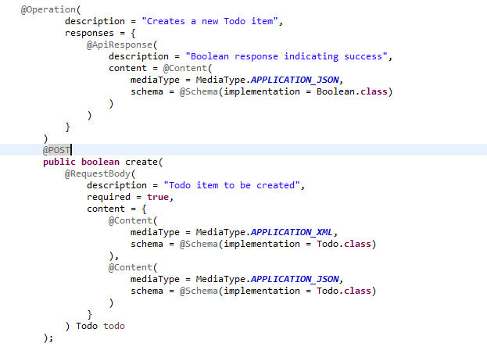
Define the createTodo endpoint (with POST and request body)
@POST maps the method to HTTP POST requests.
@RequestBody defines the body content and its expected media types.
The method accepts a Todo object as input.
@Schema(implementation = Todo.class) describes the expected request model for documentation.
The method returns a boolean, documented with @ApiResponse.

Slide 16
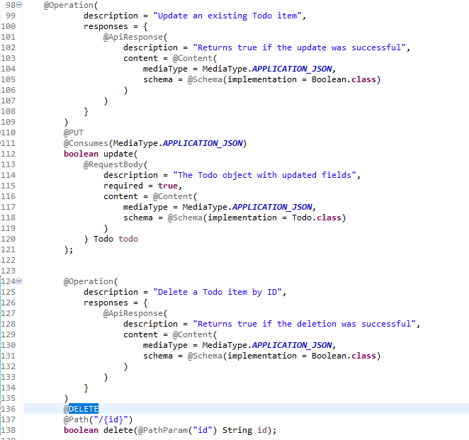
Create the TodoRestApi Interface
PUT /todos
Content-Type: application/json
{
"id": 3,
"summary": "Updated summary",
"description": "Updated description"
}
@PUT with @Consumes(MediaType.APPLICATION_JSON) is used to update an existing Todo.It takes a JSON object in the request body and returns a boolean indicating success.
DELETE /todos/3
@DELETE with @Path("/{id}") deletes a Todo by its ID.The ID is mapped using @PathParam, and the result (true/false) is returned

Slide 17
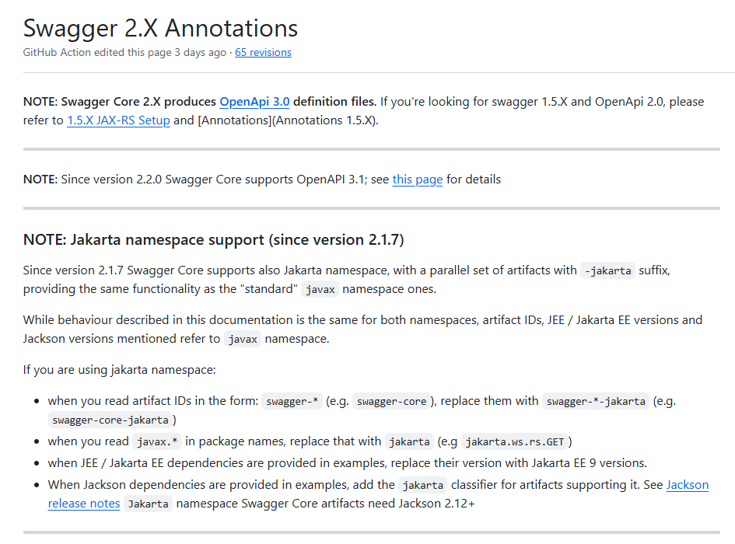
Complete Description of Swagger Annotations
1

Slide 18
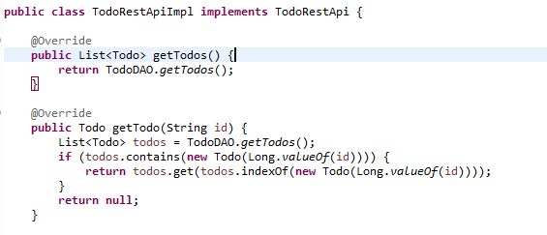
Implement the TodoRestApi Interface
TodoRestApiImpl implements all methods declared in the interface.It interacts with the TodoDAO class, which simulates a data source.The getTodos() method returns the full list of tasks while The getTodo(id) method searches and returns a specific task by its ID.

Slide 19
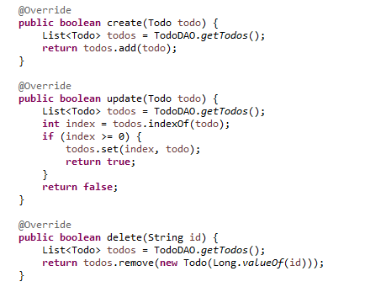
Implement the TodoRestApi Interface
create(Todo todo) method
Implements the POST operation.
It checks if the provided todo already exists in the list:
- if yes → returns false
- if not → adds the new todo and returns true
update(Todo todo) method
Implements the PUT operation.
It replaces an existing todo with the updated one by:
removing the old object (if present)
adding the new one backReturns true if updated, false otherwise.
delete(String id) method
Implements the DELETE operation.
It converts the id into a Long, creates a temporary Todo, and checks if it exists in the list:
- if yes → removes it and returns true
- else → returns false

Slide 20
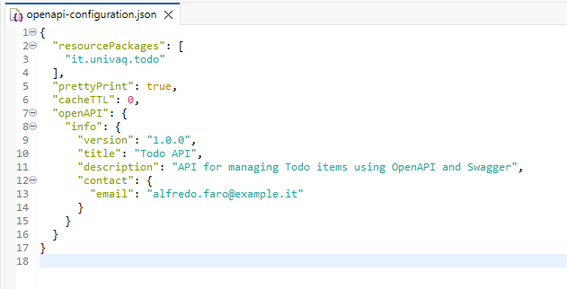
Create the openapi-configuration.json
The openapi-configuration.json file provides metadata to describe the API (version, title, description, contact) and points to the package where the REST classes are located. It is loaded automatically by Apache CXF during the OpenAPI documentation generation. This configuration enables the Swagger UI to render a complete and readable API reference.

Slide 21
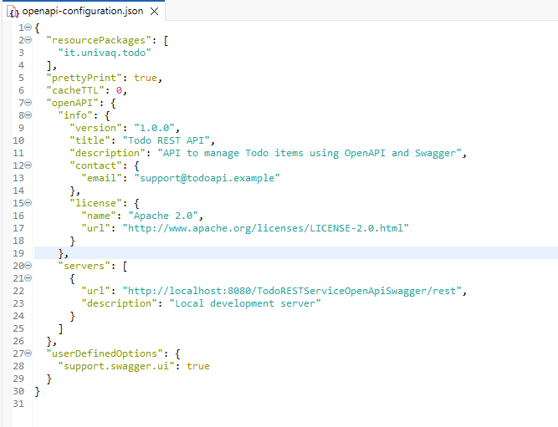
Create the openapi-configuration.json (2)
1

Slide 22
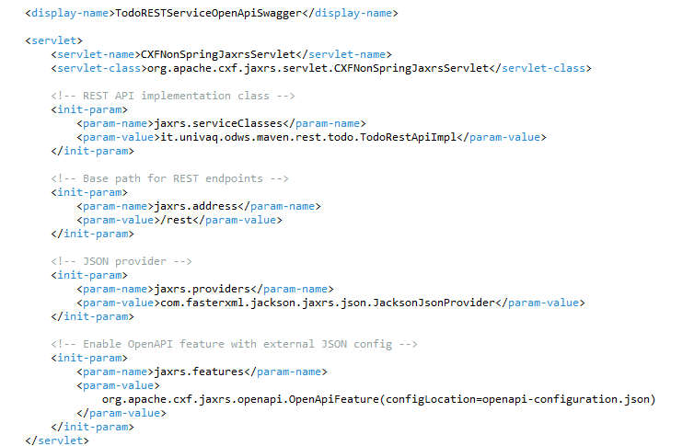
Configure the servlet [web.xml]
This configuration defines a CXFNonSpringJaxrsServlet to handle JAX-RS requests. The jaxrs.serviceClasses parameter points to the implementation class of our REST API. The jaxrs.providers parameter enables JSON serialization via Jackson. The jaxrs.features parameter activates the OpenApiFeature, which uses openapi-configuration.json to auto-generate Swagger docs.

Slide 23
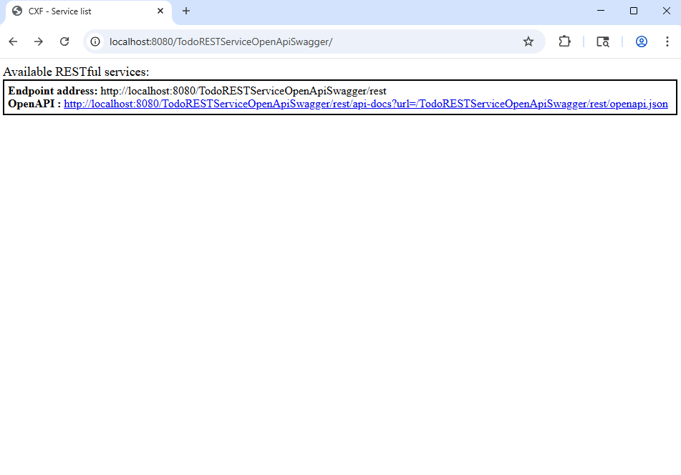
Deploy the REST Service
1

Slide 24
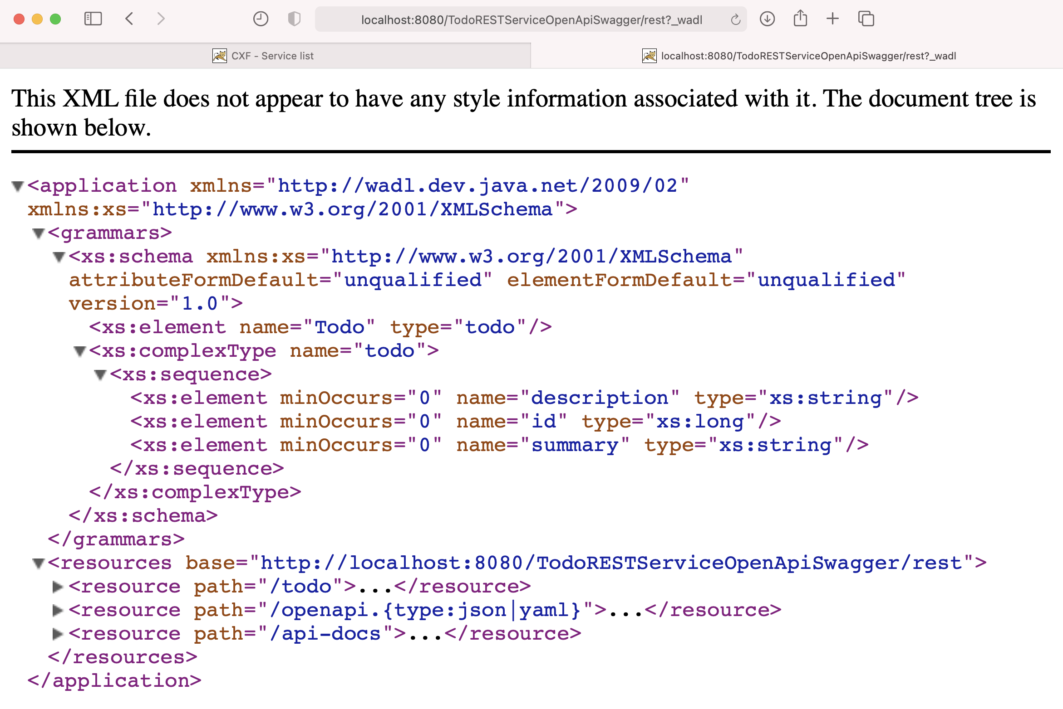
The REST API description - WADL
1
3
2

Slide 25
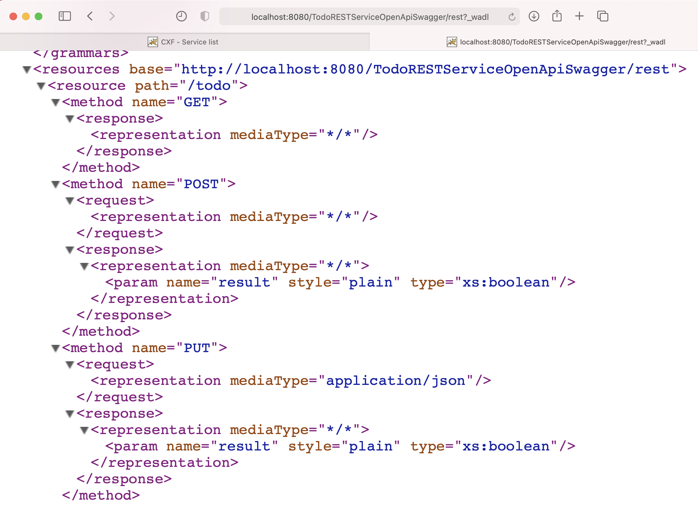
The REST API description - WADL
1.1
1.2
1.3

Slide 26
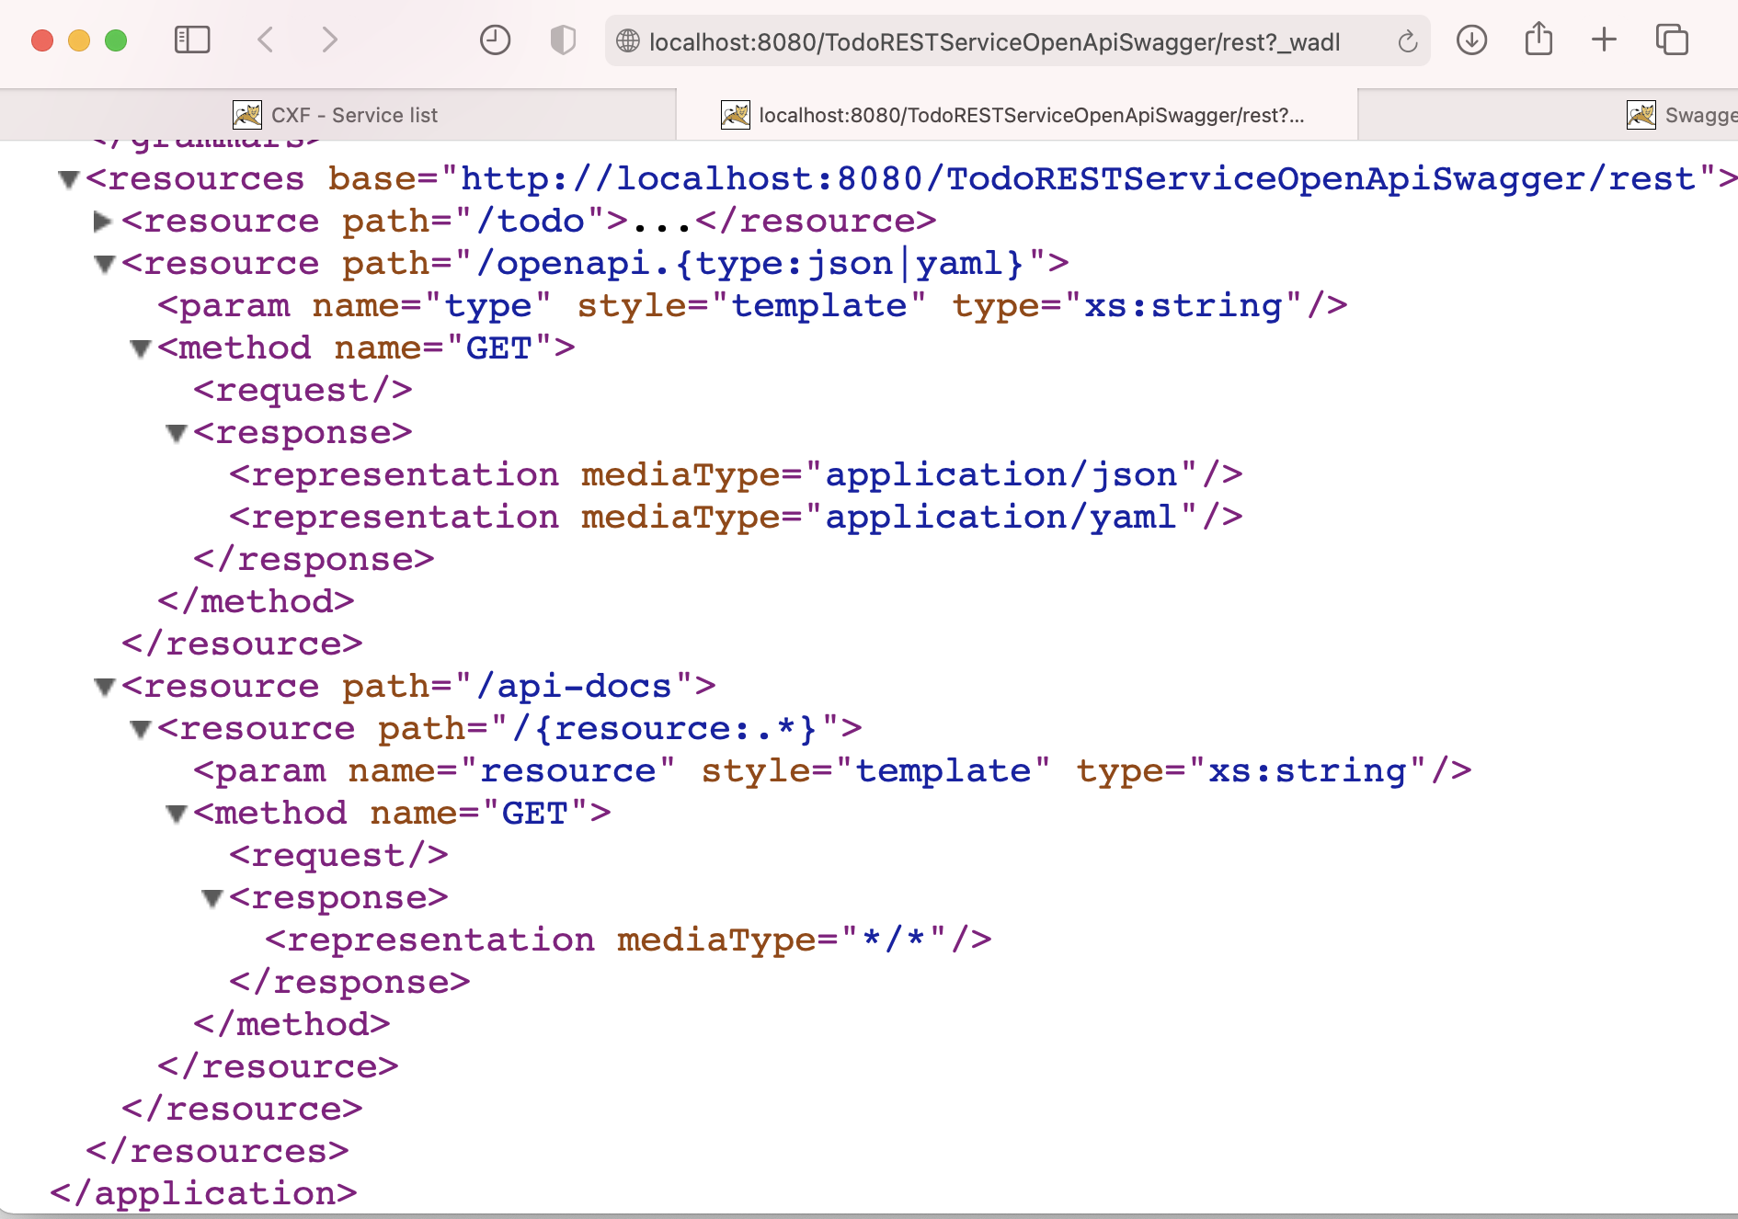
The REST Api description - WADL
2
2.1
3
3.1

Slide 27
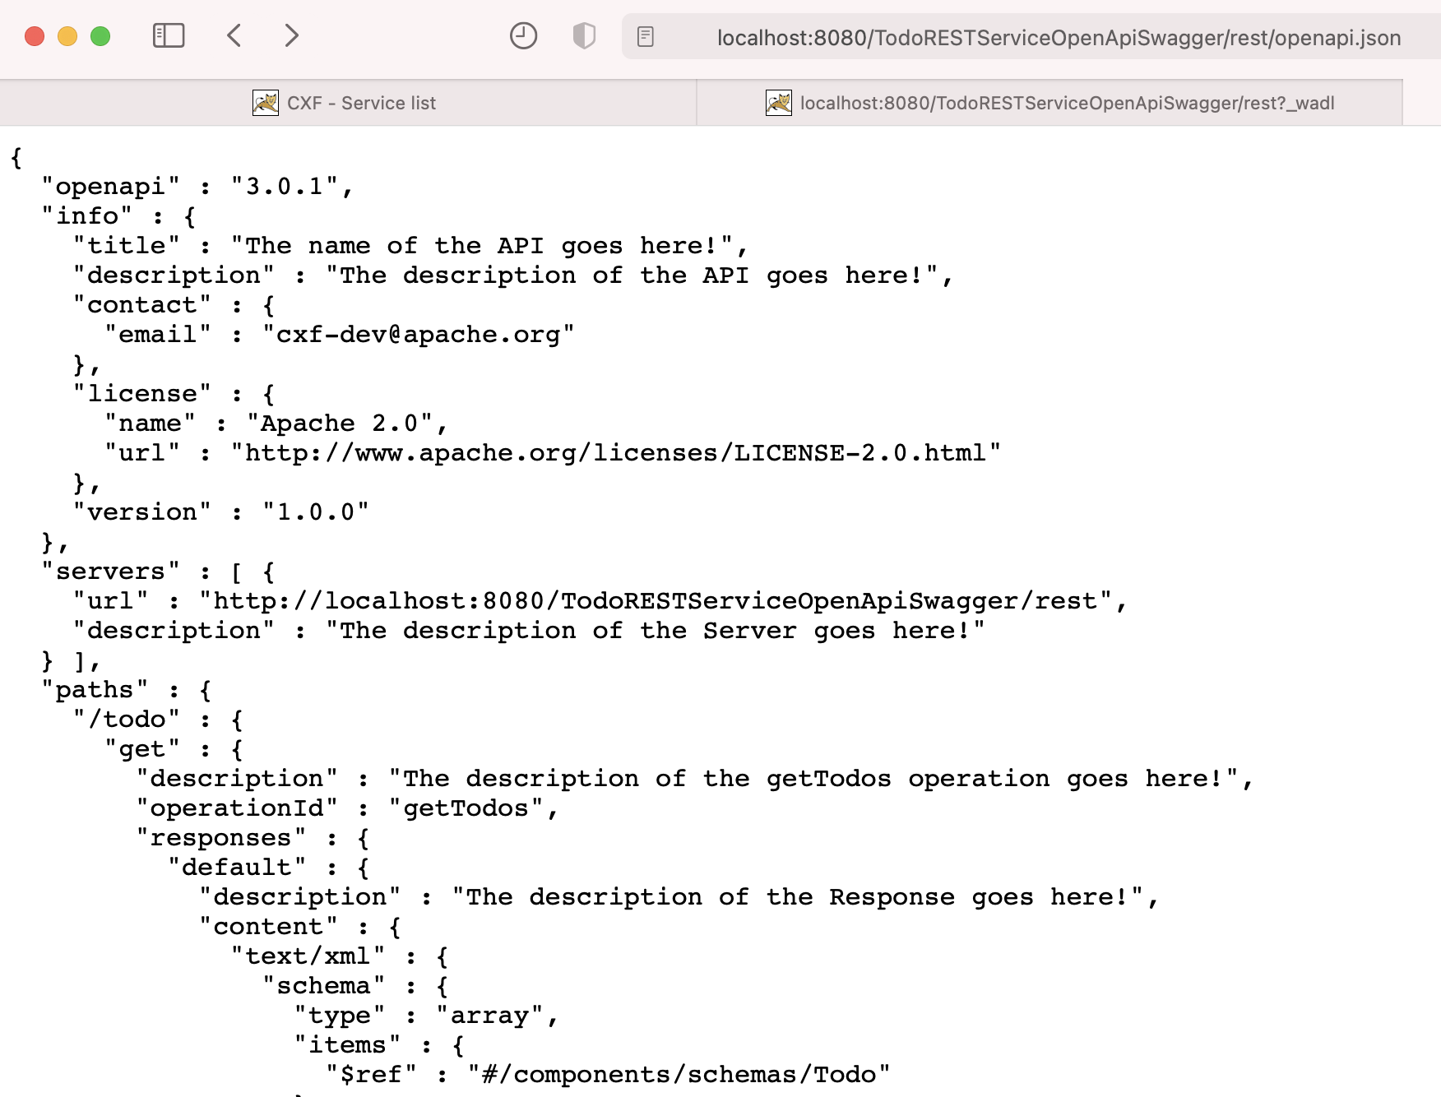
The REST API description - JSON
1

Slide 28
The REST Api description - YAML
1
2
2

Slide 29
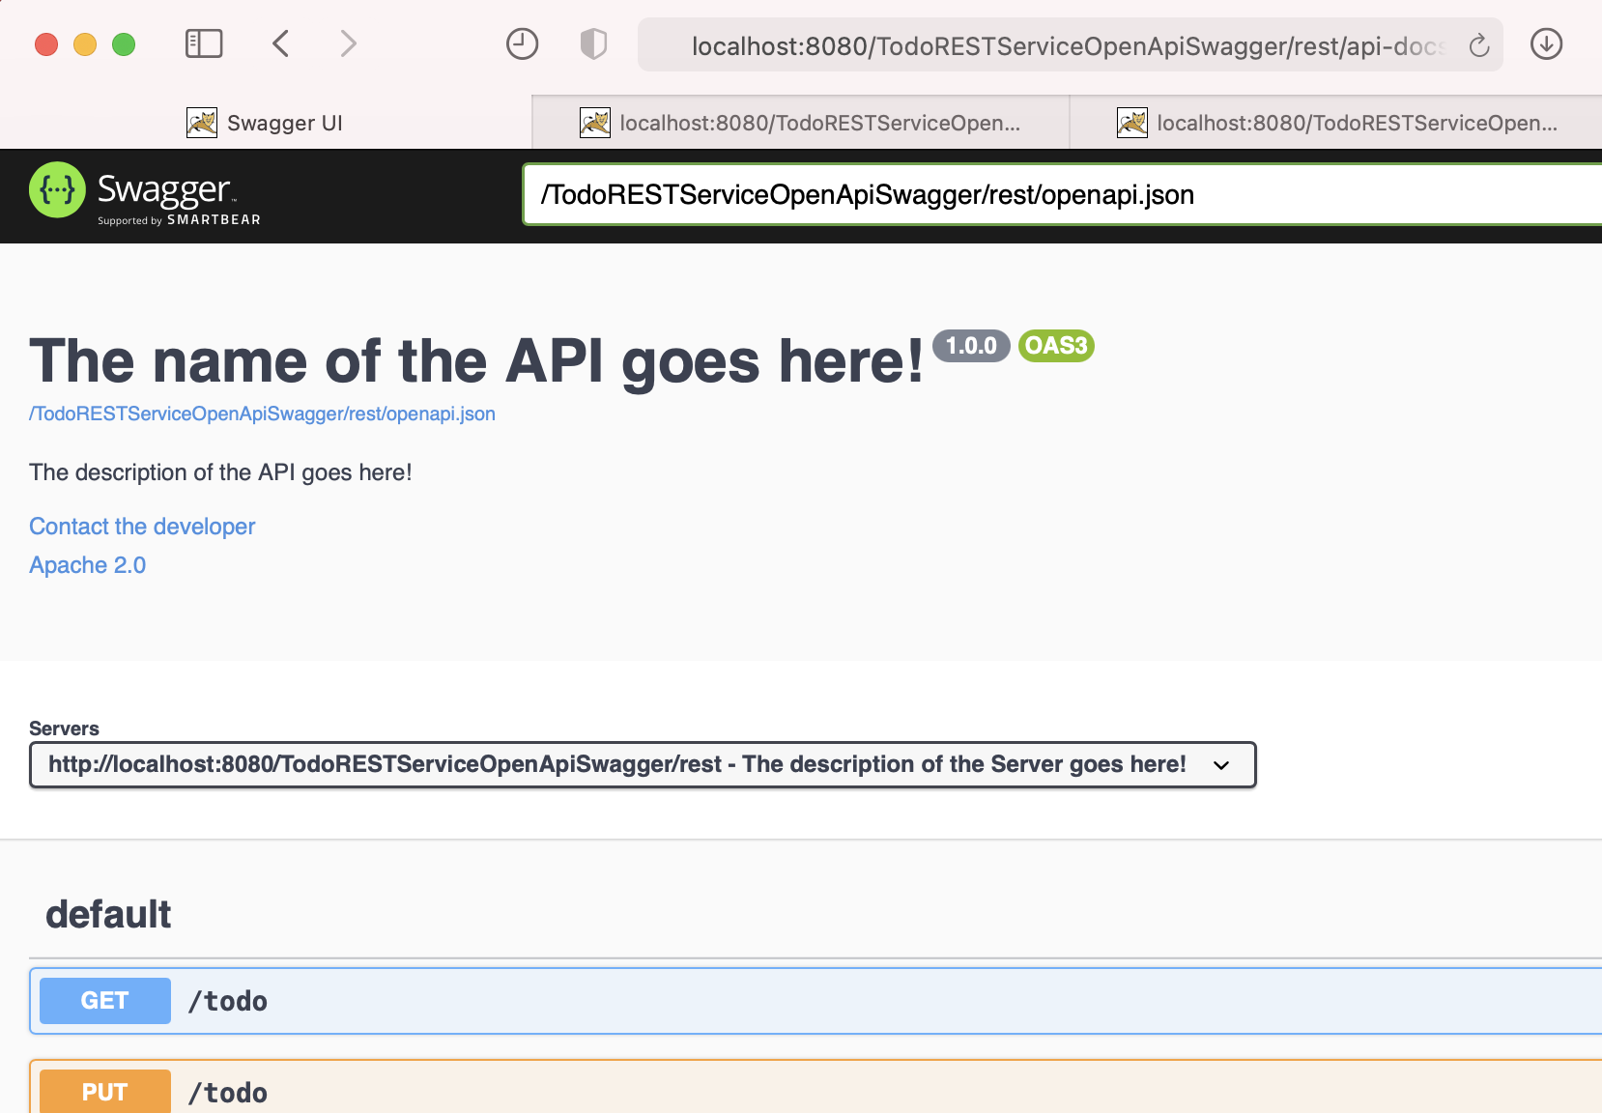
Swagger api-docs
1
2
point to .yaml or .json url
3

Slide 30
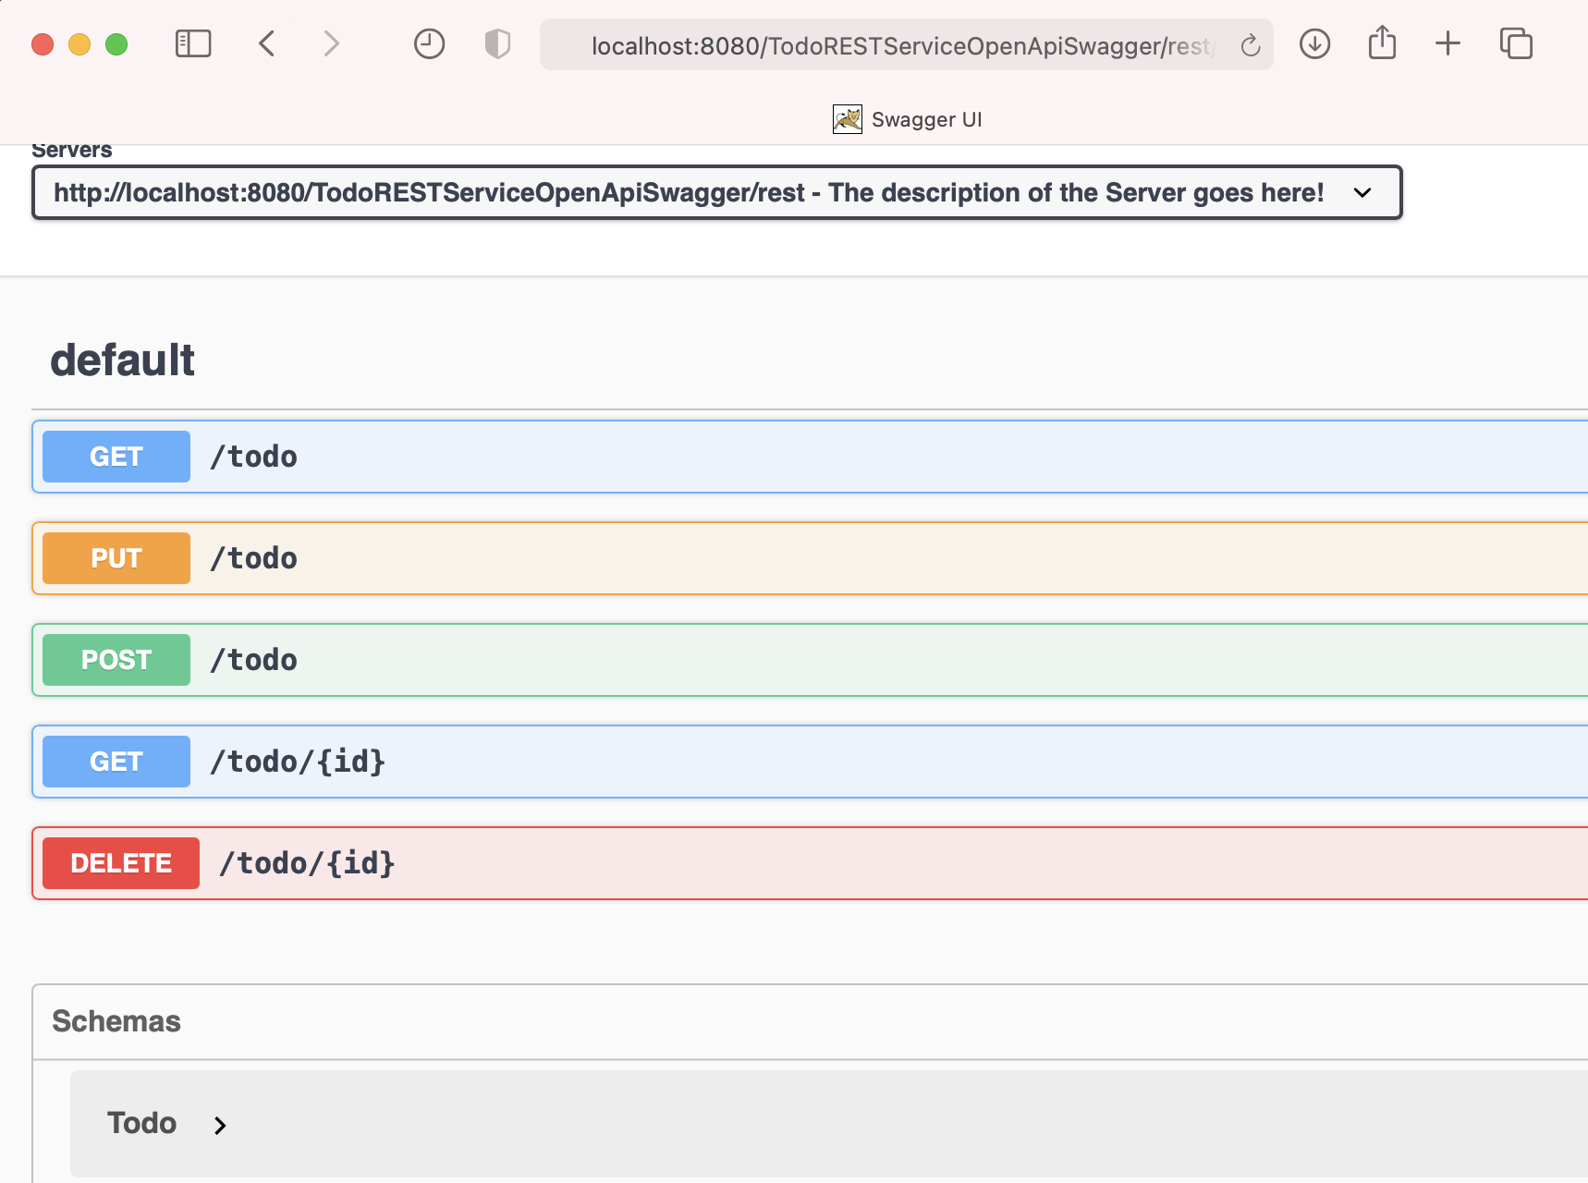
Swagger api-docs
List<Todo> getTodos()
boolean update(Todo todo)
boolean create(Todo todo)
Todo getTodo(String id)
boolean delete(String id)

Slide 31
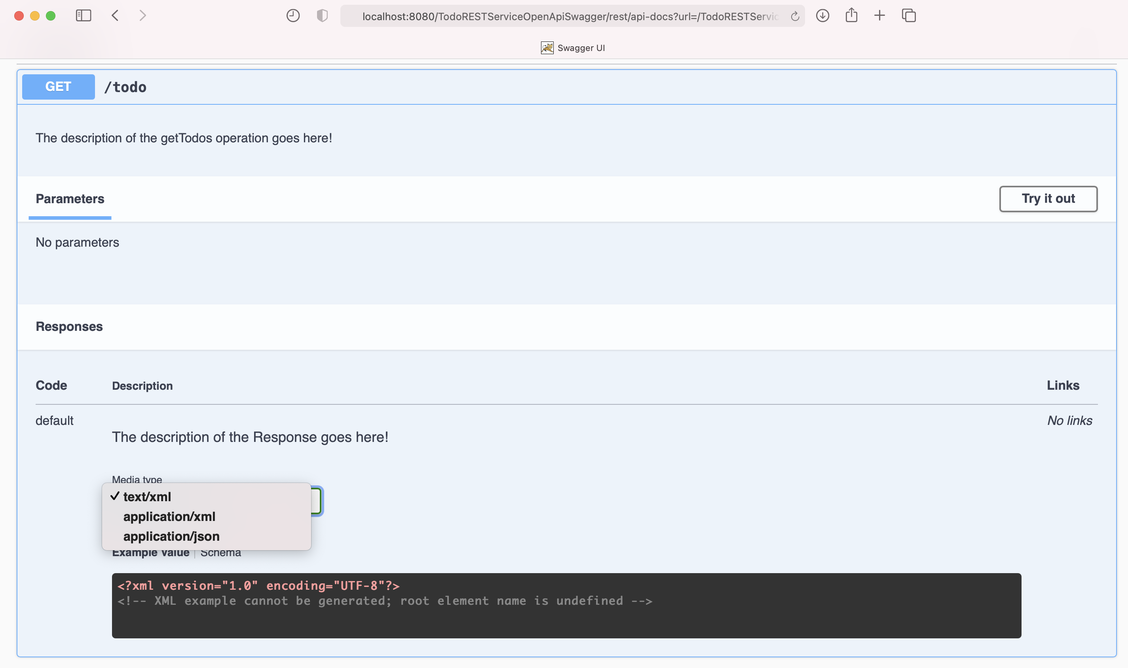
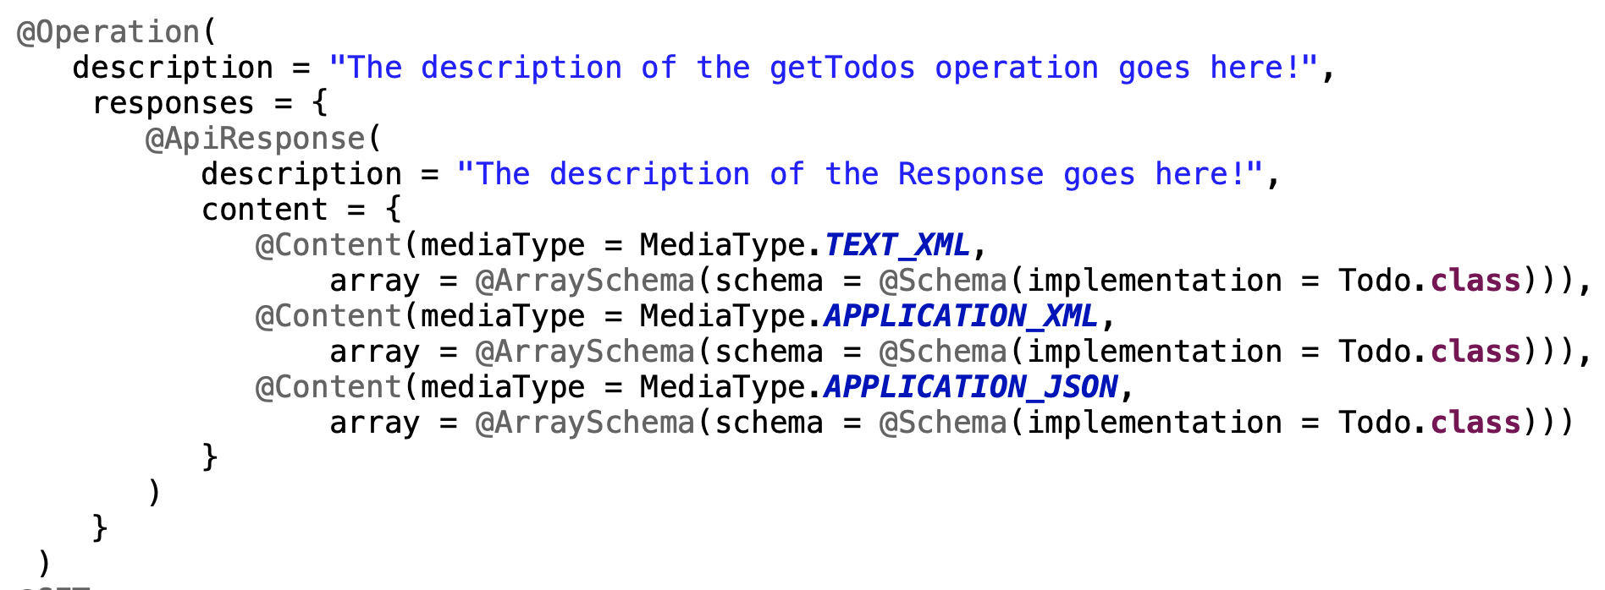
Try to invoke GET /todo
List<Todo> getTodos()
1
2
3

Slide 32
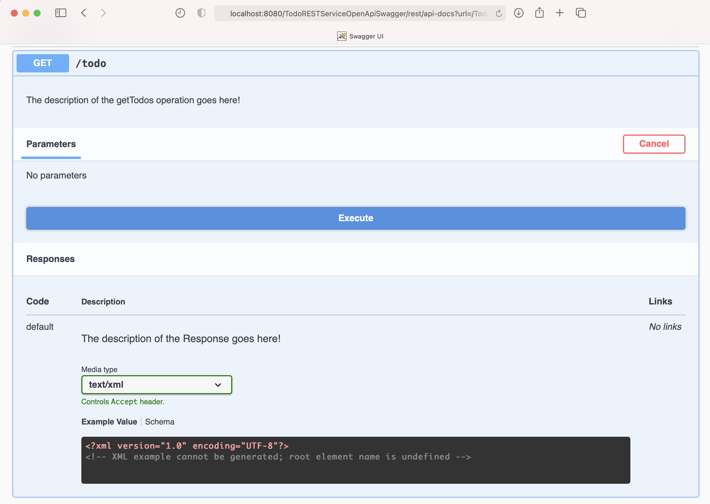
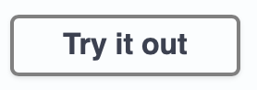
Try to invoke GET /todo
1
2

Slide 33
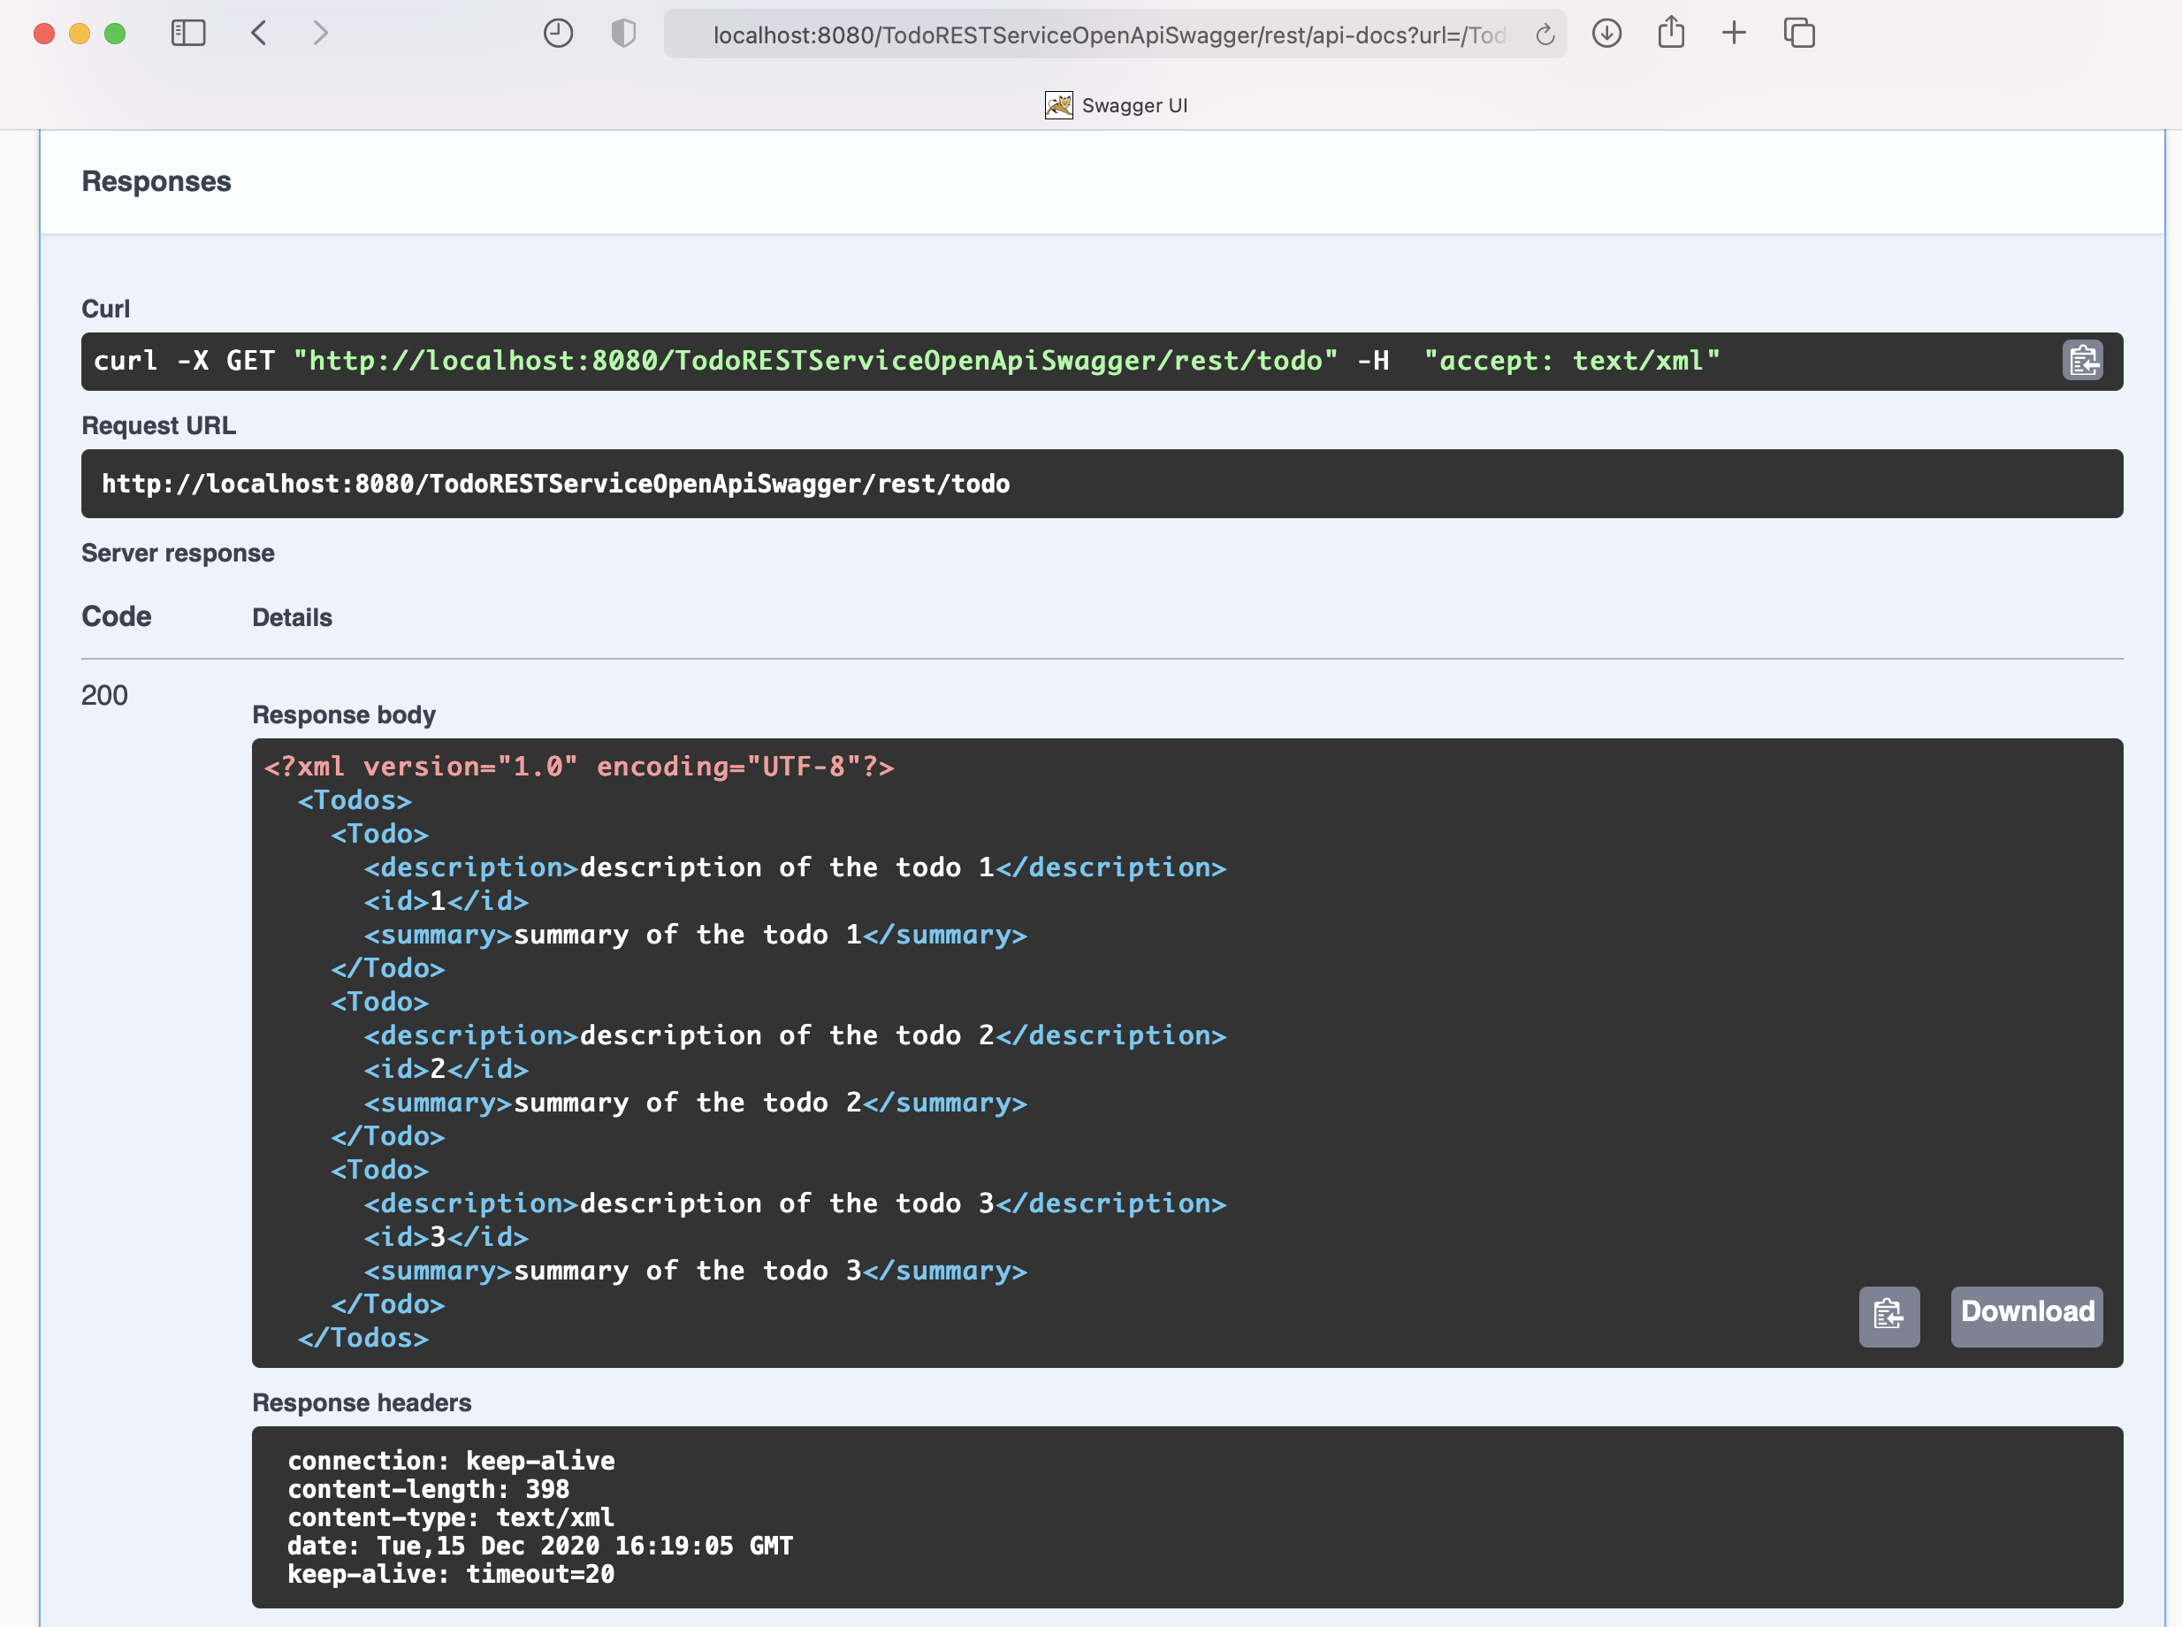
Try to invoke GET /todo
1
2
XML response body

Slide 34
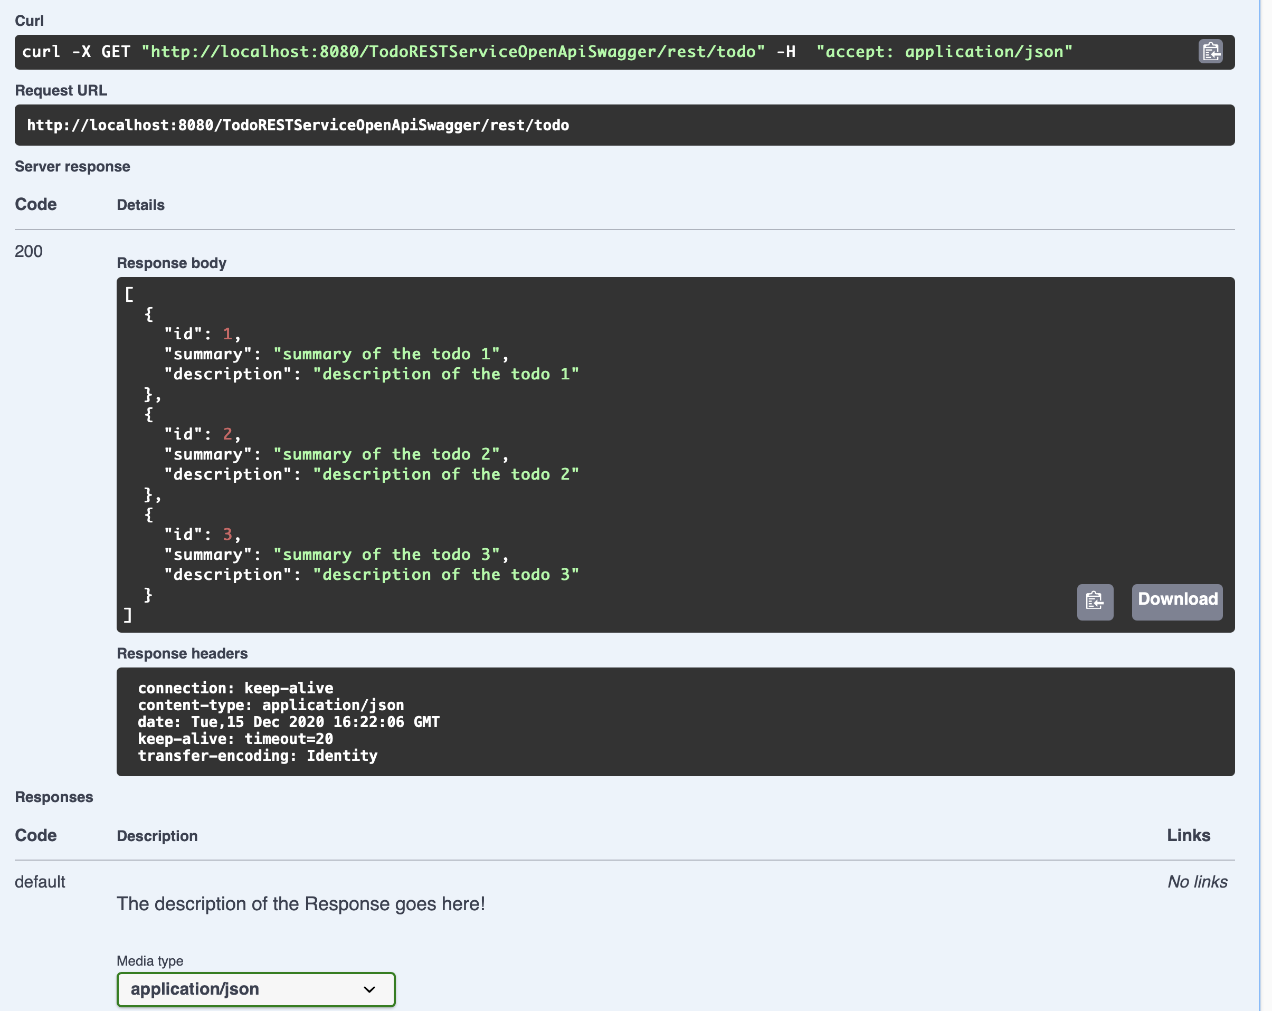
Try to invoke GET /todo
1
2
JSON response body
1

Slide 35
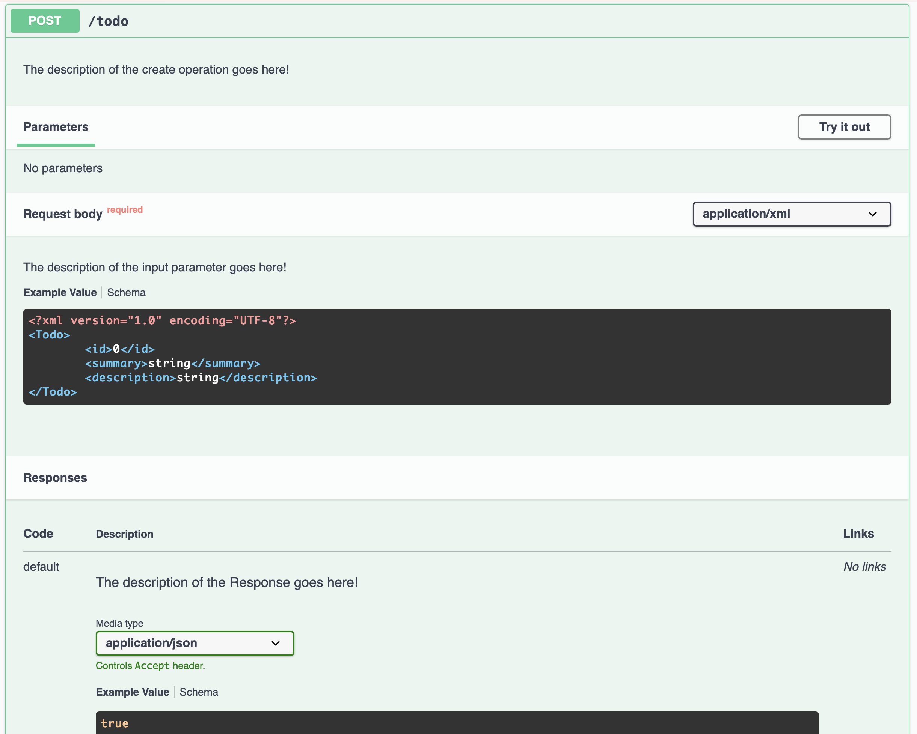
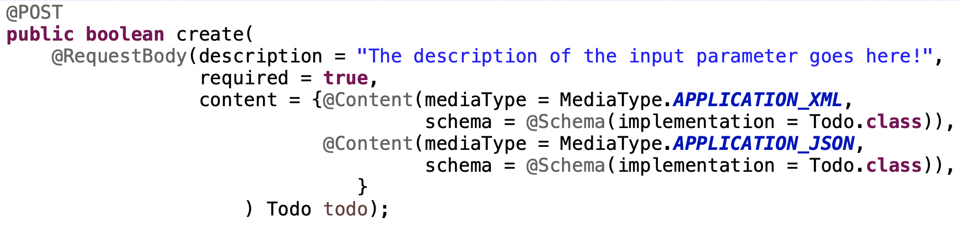
Try to invoke POST /todo
boolean create(Todo todo)
2
1
3

Slide 36
Try to invoke POST /todo
XML request body
1
2
3

Slide 37
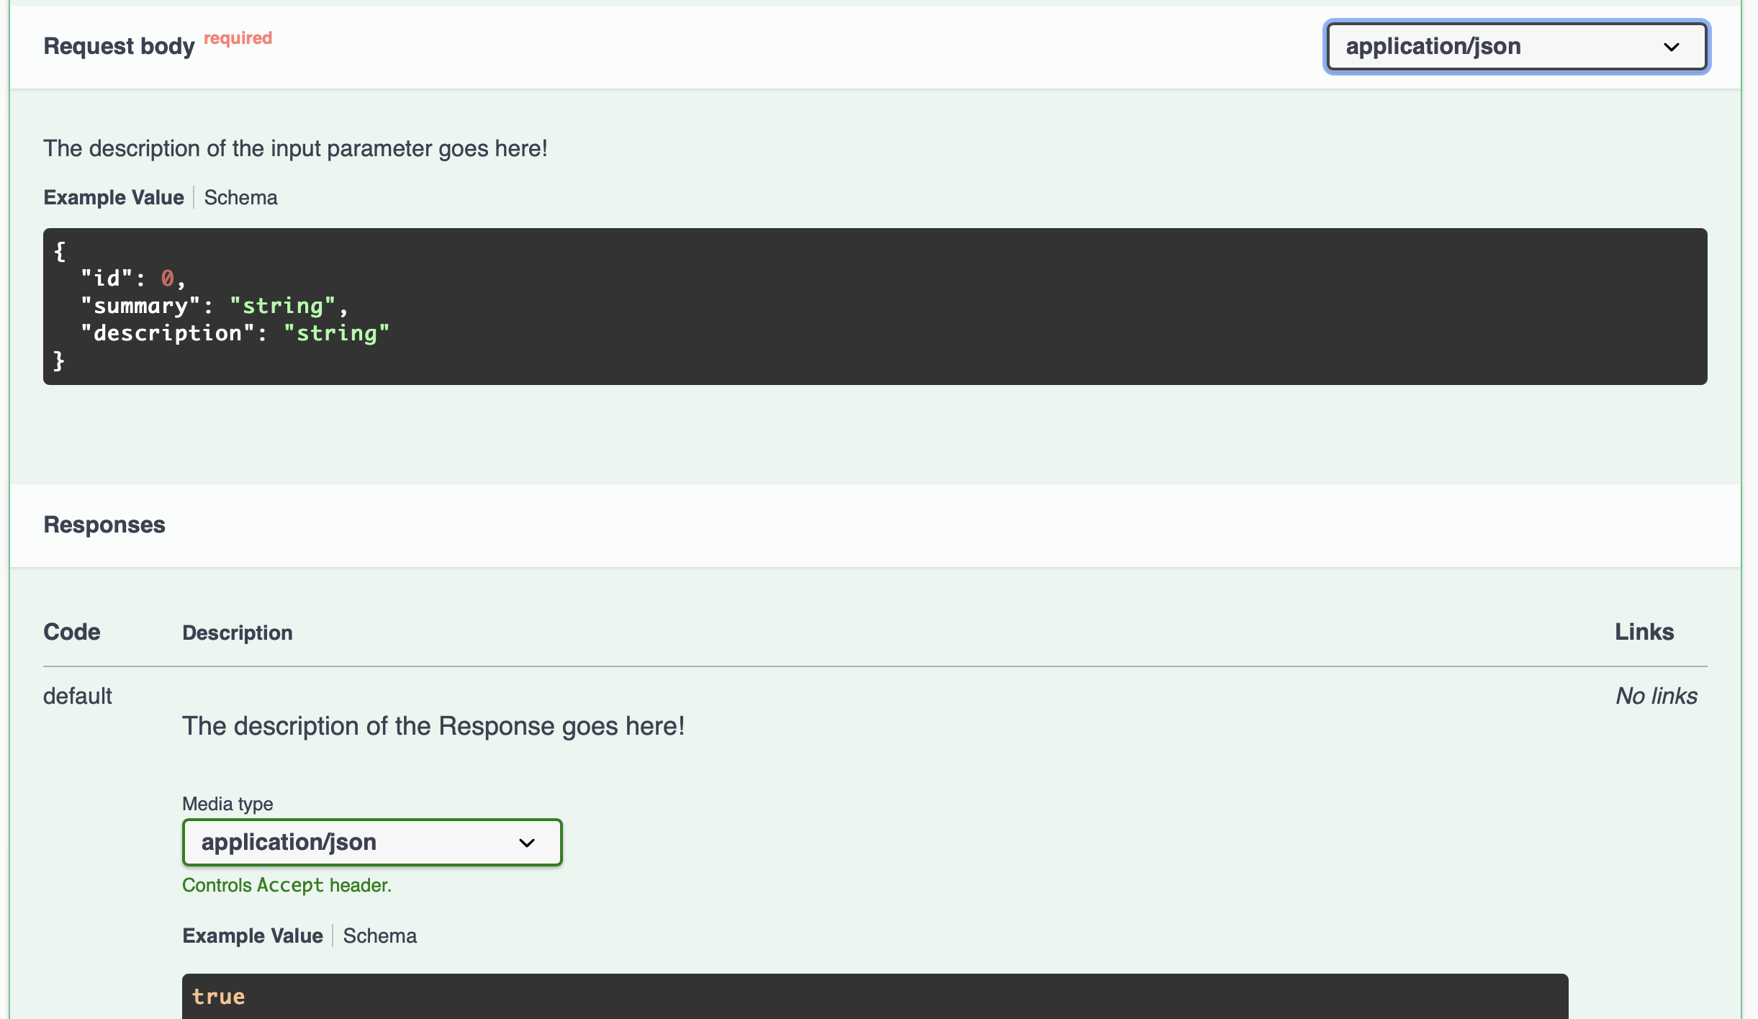
Try to invoke POST /todo
1
2
JSON request body

Slide 38
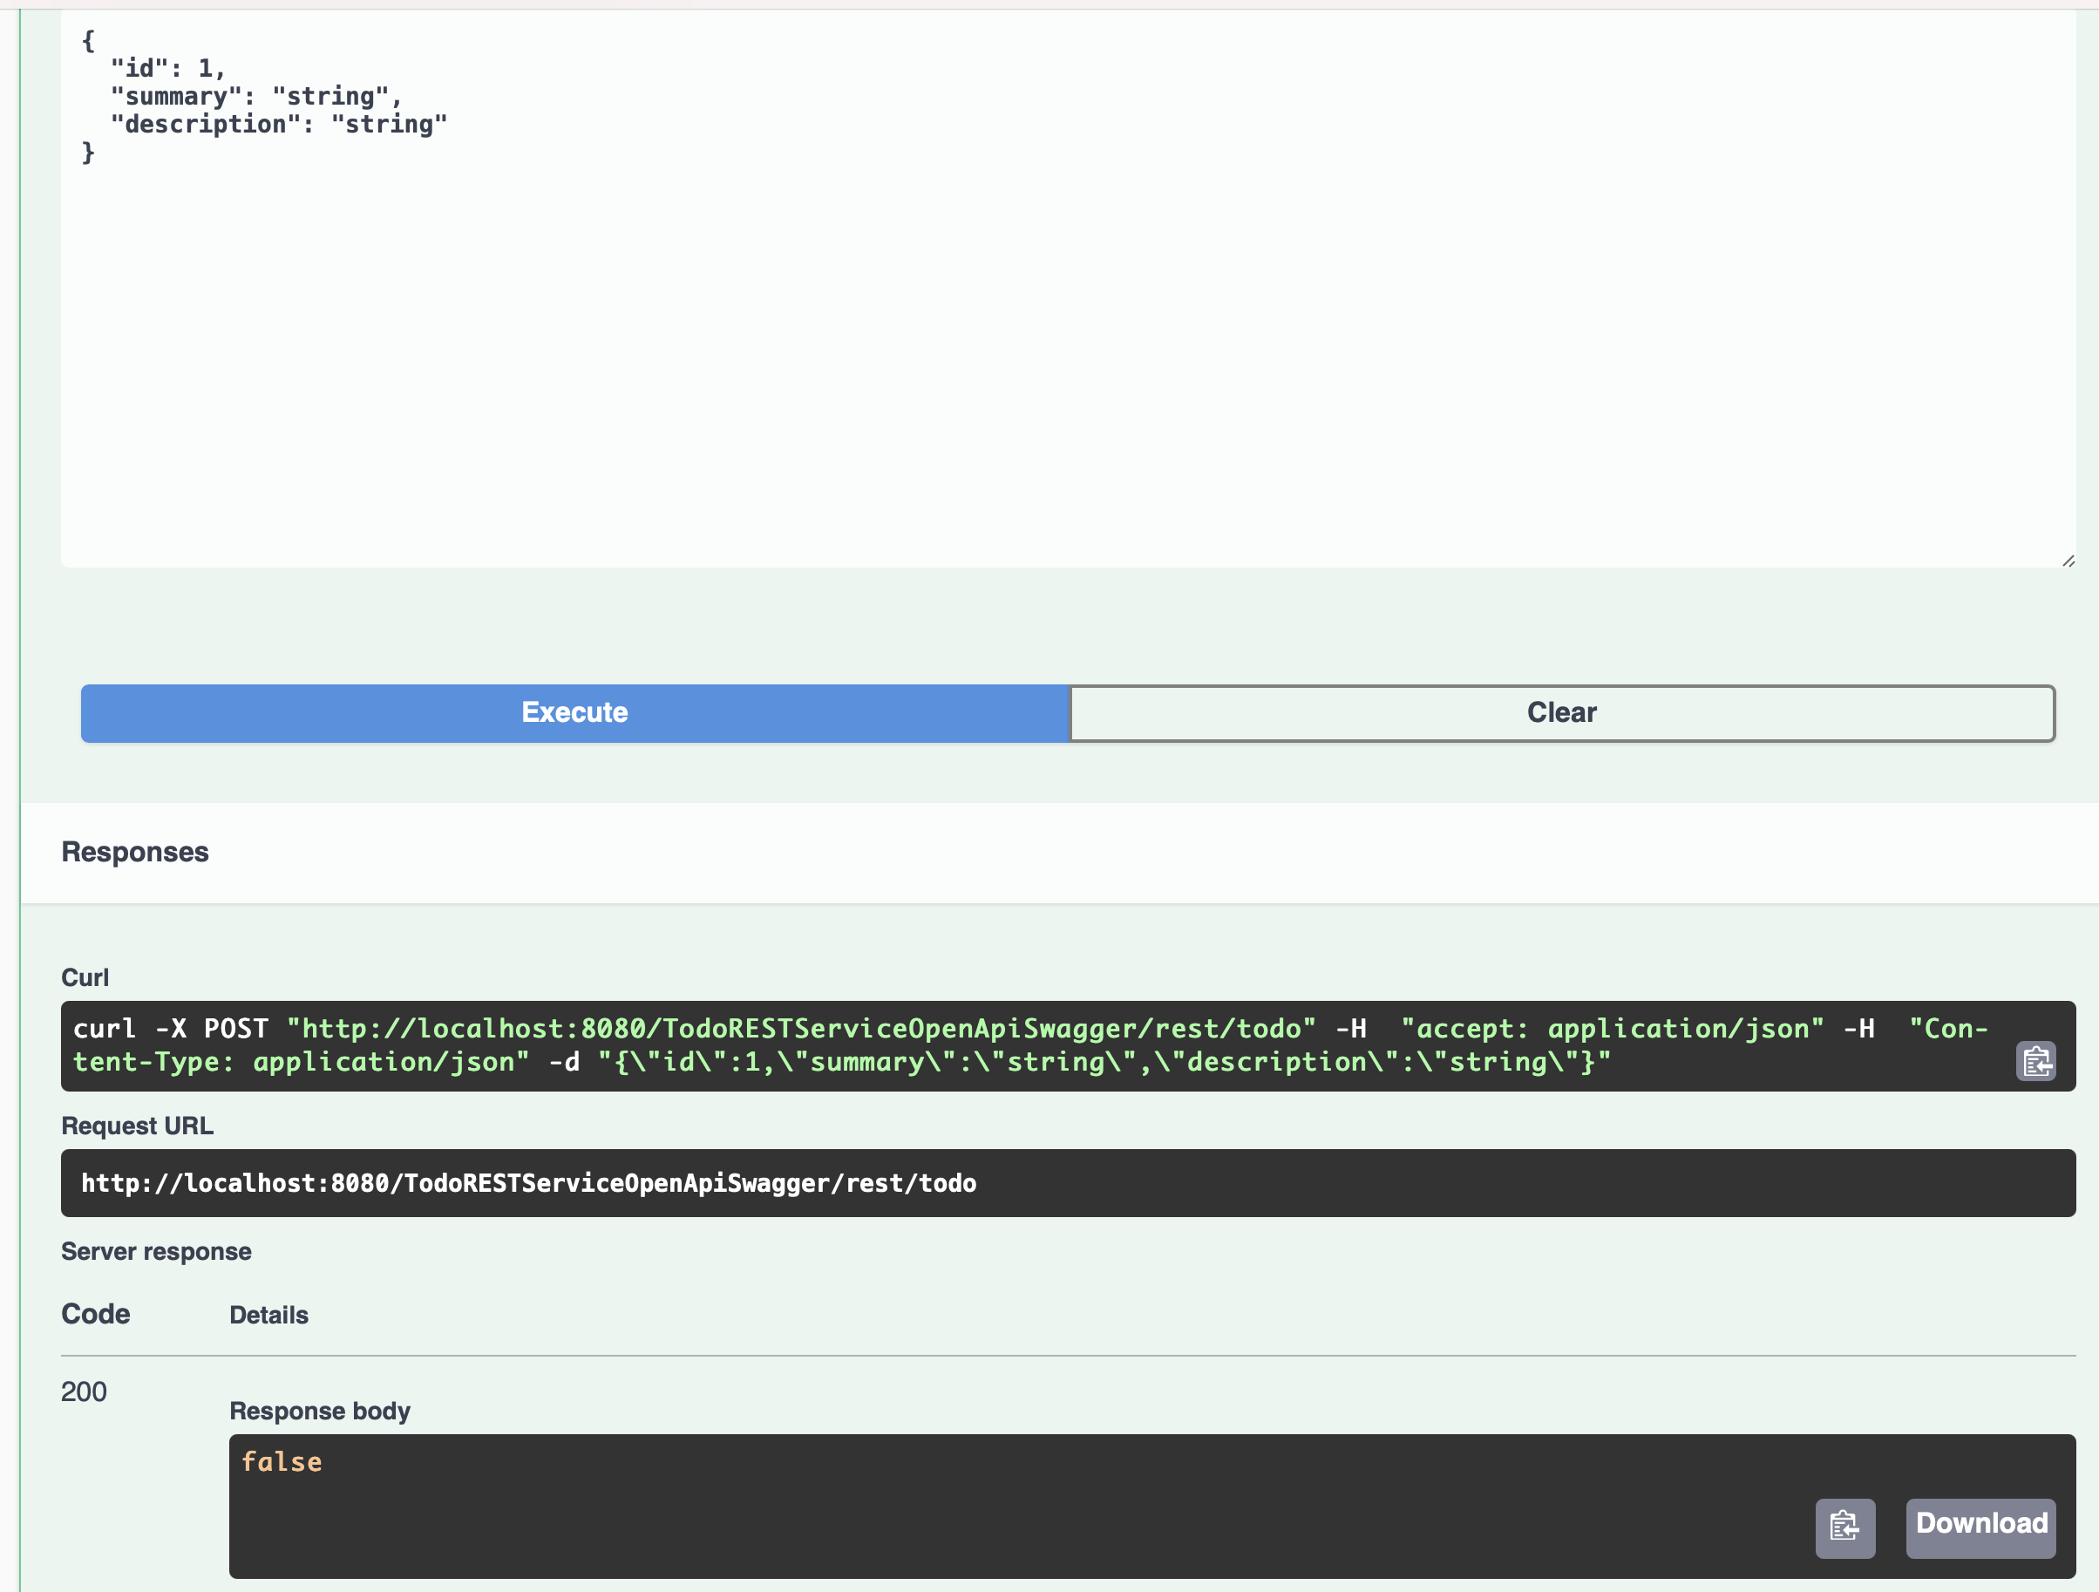
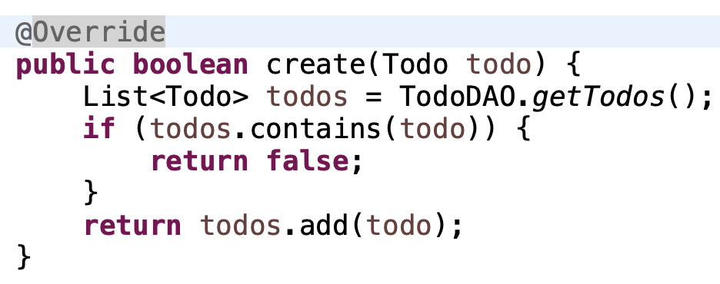
Try to invoke POST /todo
1

Slide 39

Try to invoke POST /todo
1

Slide 40
Generate a “jaxrs-cxf-client”
for our REST service

Slide 41
Save the JSON or YAML Description
1

Slide 42
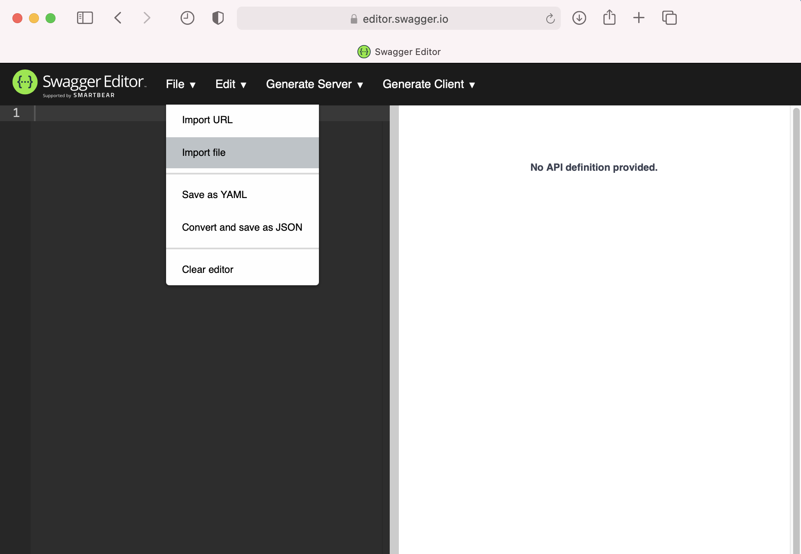
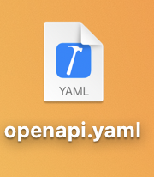
Import the JSON or YAML Description
1
2
1
I opted for importing the openapi.yaml file

Slide 43
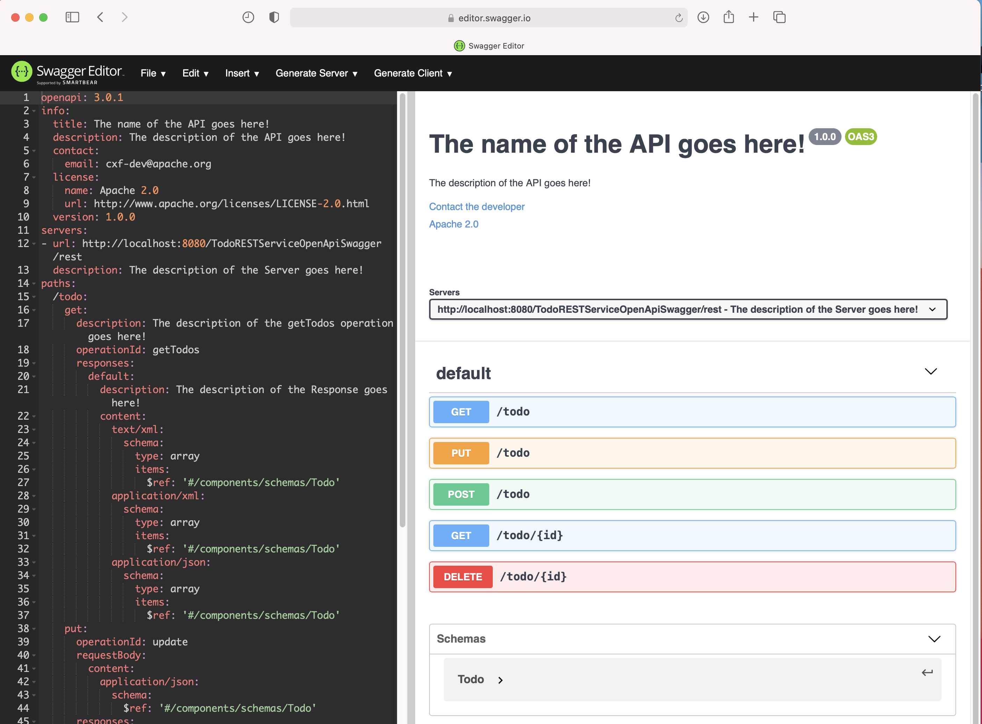
Import the JSON or YAML Description
1

Slide 44
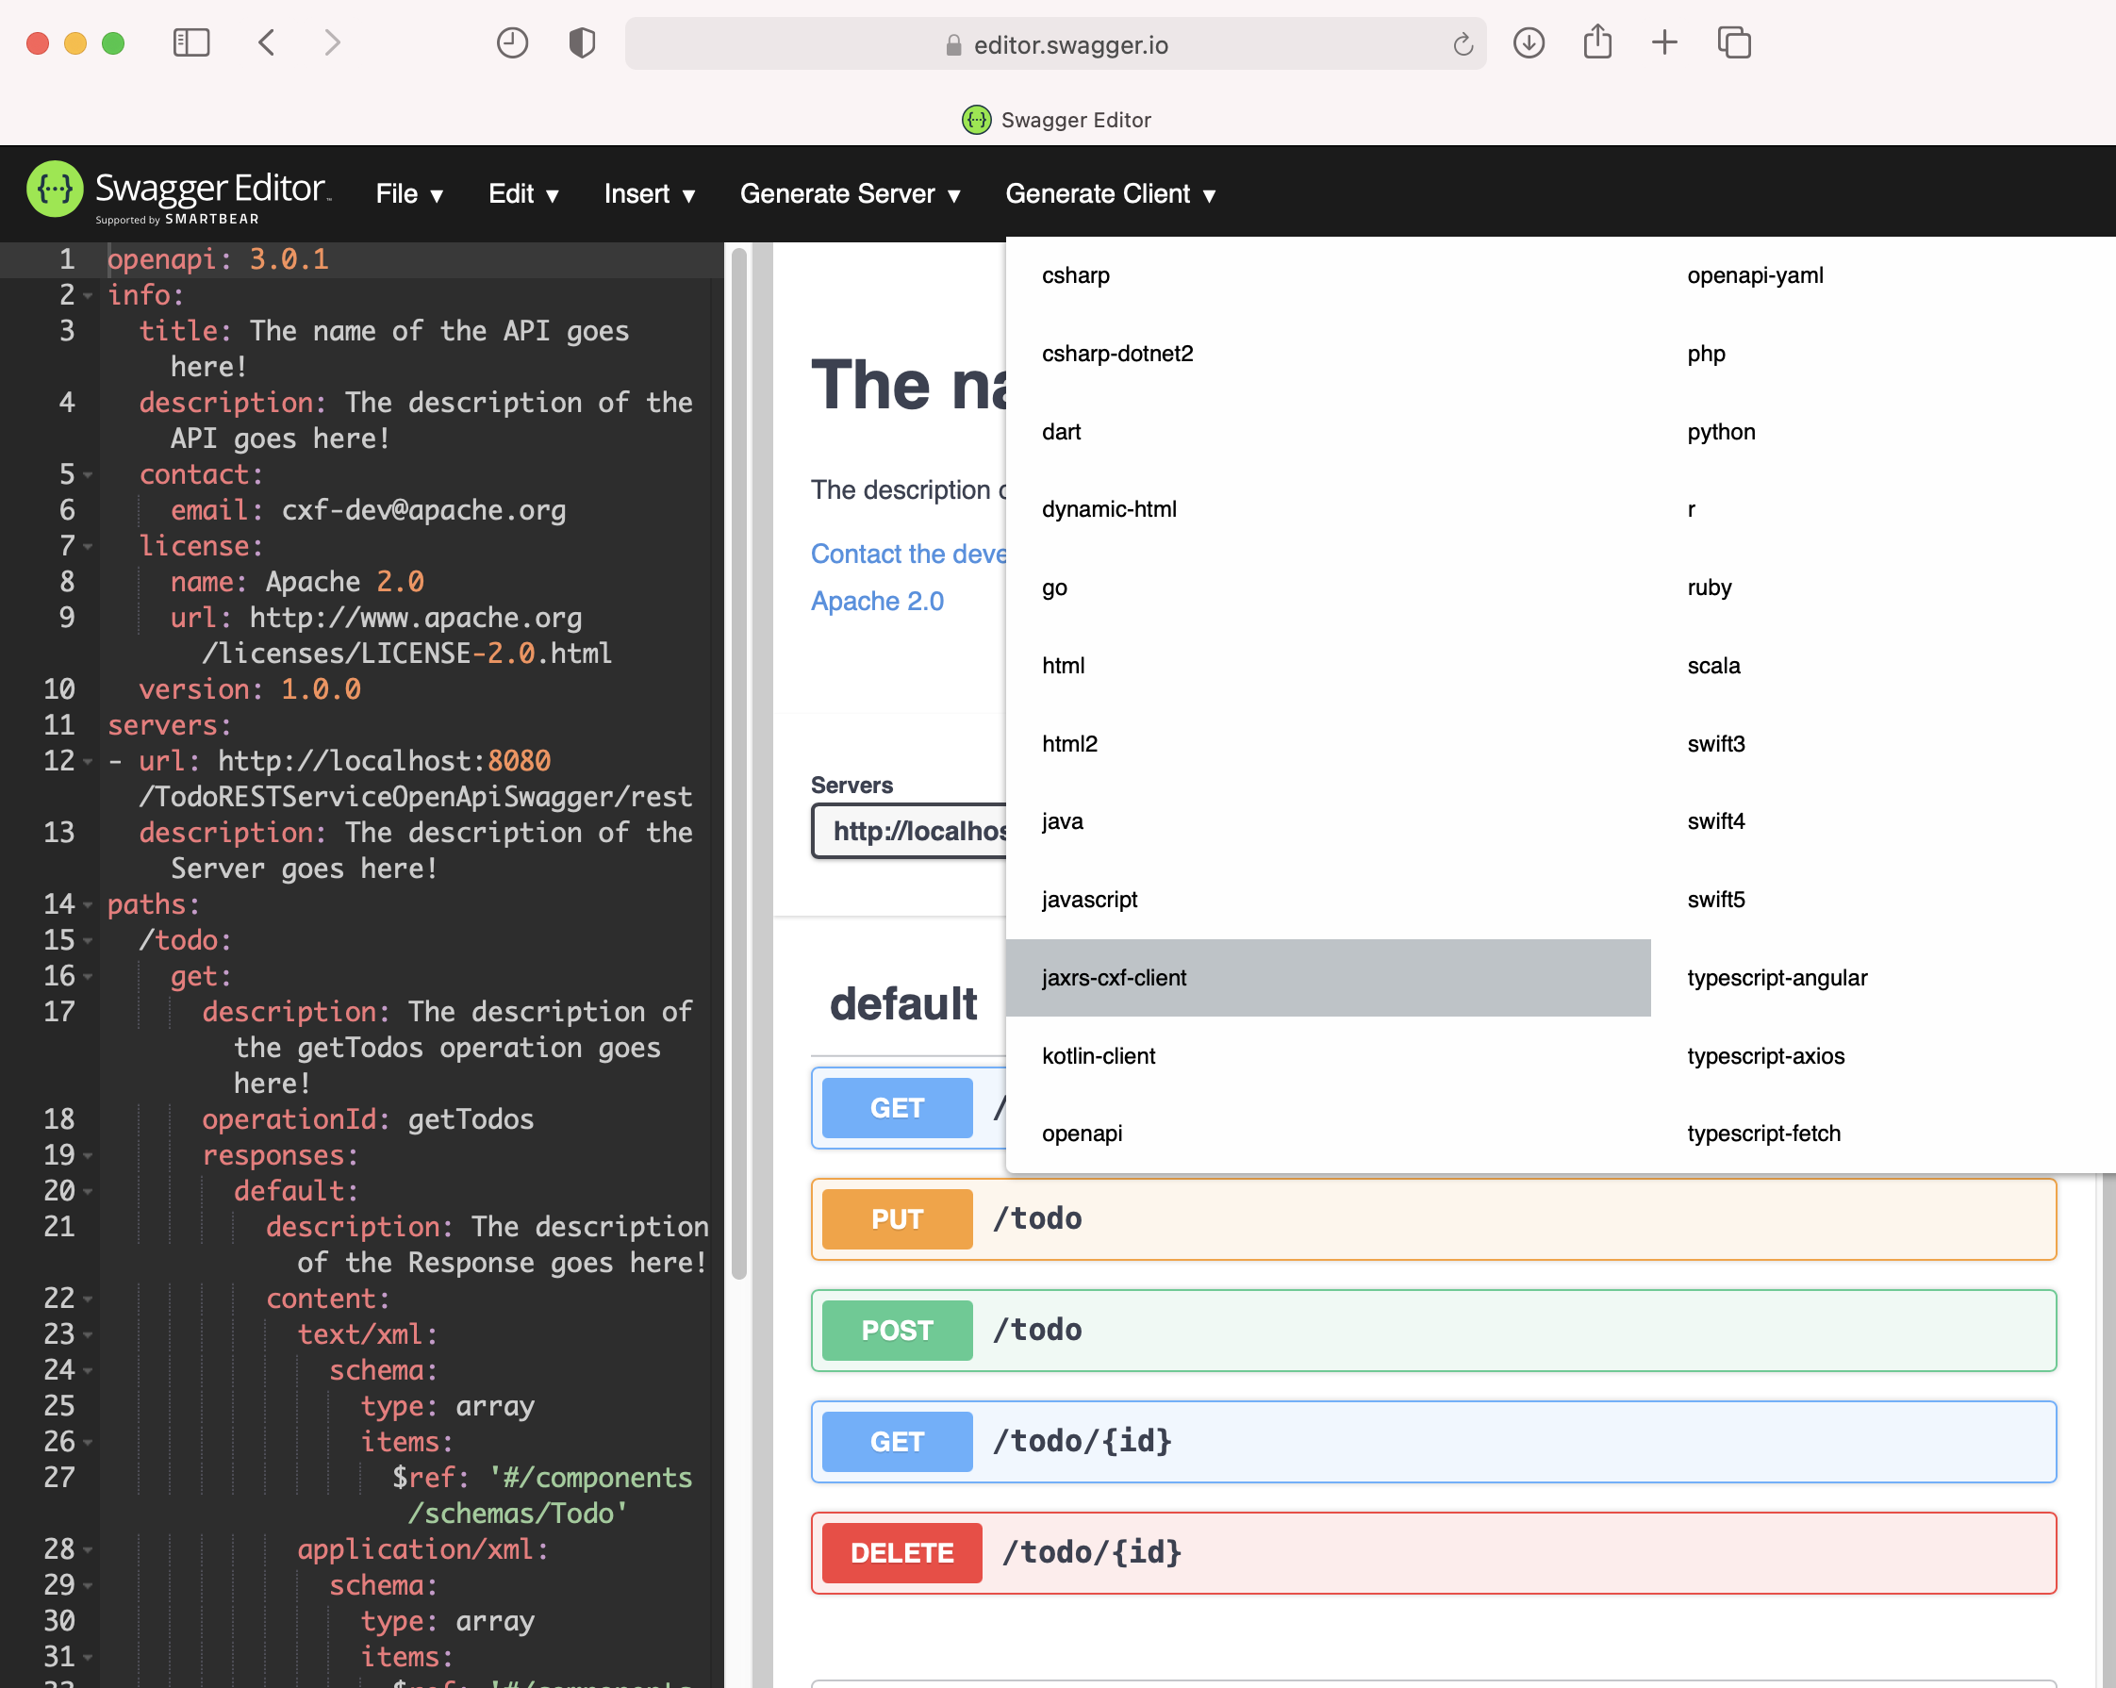
Generate the jaxrs-cxf-client Project
1
2

Slide 45
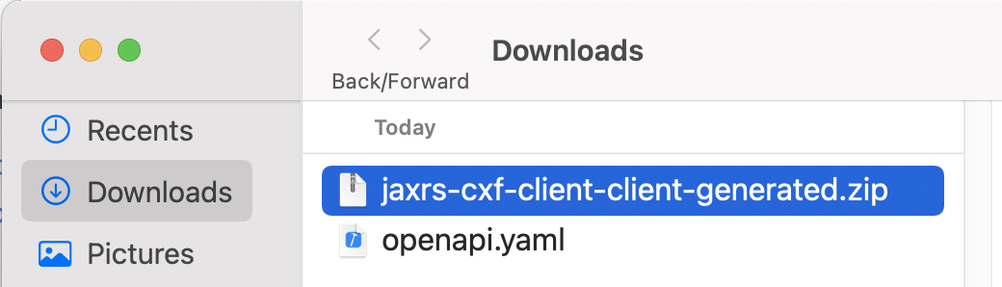
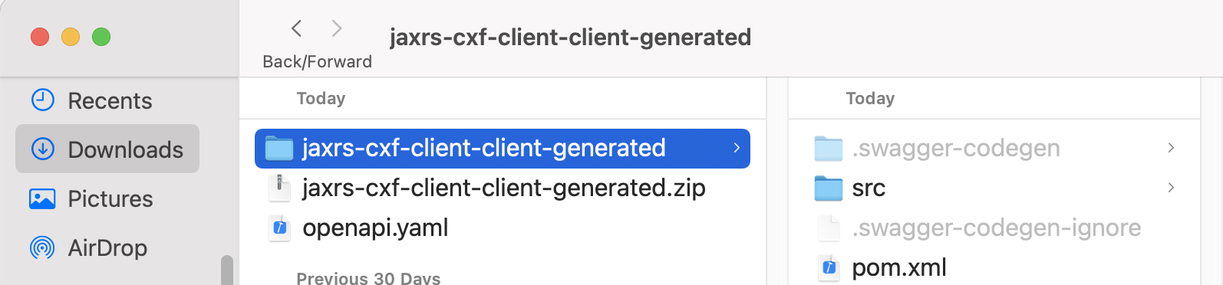
Generate the jaxrs-cxf-client Project
1
2
You get a mavenized project... That’s simply great ☺

Slide 46
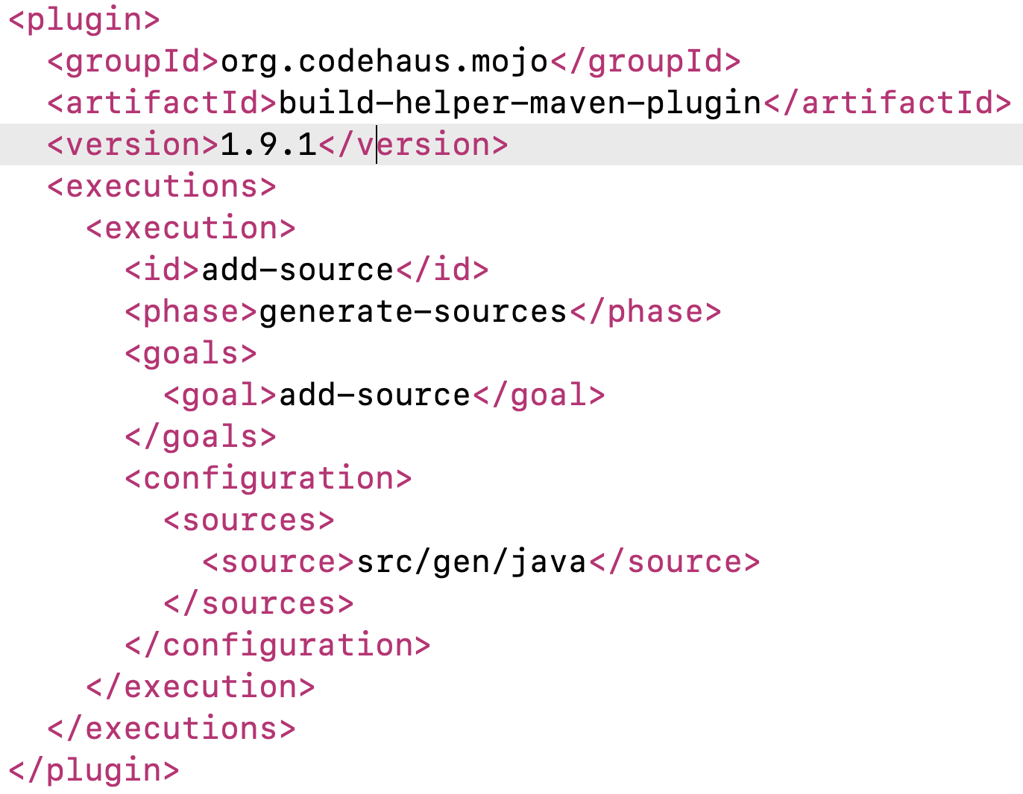
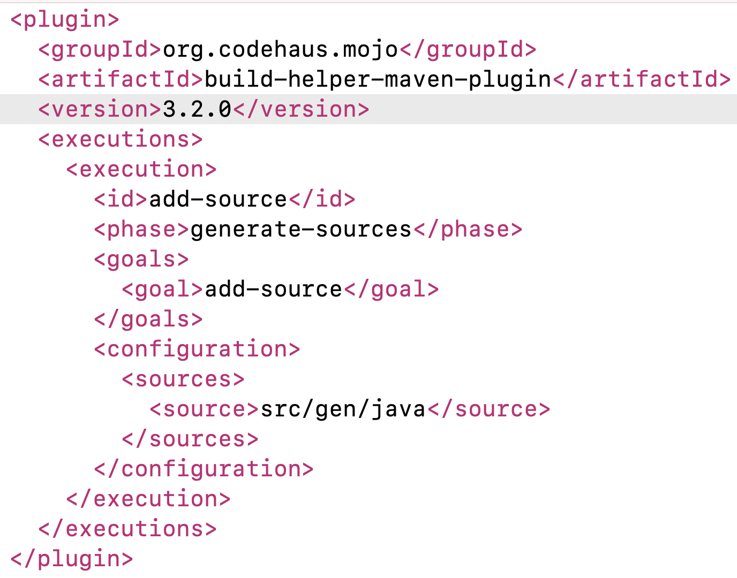
Fix the pom.xml
Fix the version

Slide 47
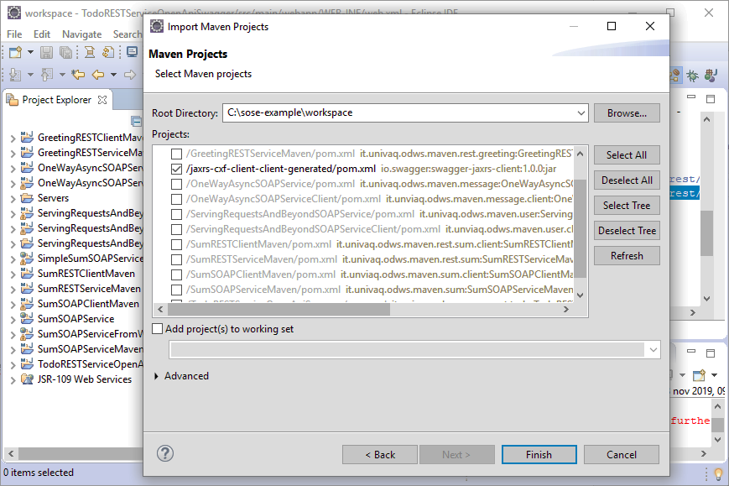
Import the jaxrs-cxf-client Project
1

Slide 48
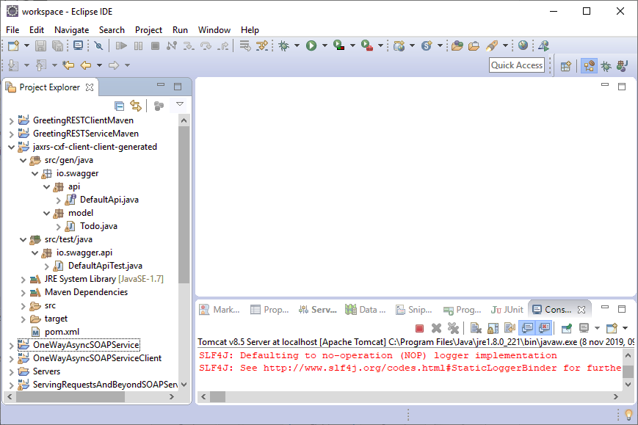
Check the Generated Classes
1
2

Slide 49

Check the Generated Classes
Since it is a “create” operation, the code 201 would be more appropriate
1
2
https://restfulapi.net/http-status-codes/

Slide 50

Fix the Todo Class
1
@javax.xml.bind.annotation.XmlRootElement
Maps a class or an enum type to an XML element

Slide 51

Check the DefaultApiTest Class
1

Slide 52

Implement the createTest
1
2
3
4
5

Slide 53

Implement the deleteTest
1
2
3
4
5

Slide 54

Implement the getTodoTest
1
2
3
4

Slide 55

Implement the getTodosTest
1
2
3

Slide 56

Implement the updateTest
1
2
3

Slide 57

Execute Tests
Do not forget to run the “TodoRESTServiceOpenApiSwagger” service first ☺
2
3
1

Slide 58

Check Tests Execution
1
2

Slide 59

Generating the REST Client
That’s the method we have used so far for generating the REST Client
https://fizzylogic.nl/2018/09/26/learn-how-to-quickly-generate-rest-clients-from-swagger-files/

Slide 60

Alternative Way for Generating the REST Client (1/3)

Slide 61

Alternative Way for Generating the REST Client (2/3)
Three arguments → next slide

Slide 62

Alternative Way for Generating the REST Client (3/3)

Slide 63
References
http://cxf.apache.org/docs/openapifeature.html
https://swagger.io/docs/specification/about/
https://swagger.io/
https://voicebase.readthedocs.io/en/v3/how-to-guides/swagger-codegen.html#download-swagger-codegen-cli-tool
https://fizzylogic.nl/2018/09/26/learn-how-to-quickly-generate-rest-clients-from-swagger-files/

